Slide 1
Digitalization of Innovation and Implications for SDGs: Japan’s Experience of Developing Smart Cities
Masaru YARIME
City University of Hong Kong
Japan International Cooperation Agency Research Institute
18th Global Development Conference
Science, Technology, and Innovation for Development
New Delhi, India, 22-23 March 2018

Slide 2
Conventional Model of the Innovation Process
Greenhalgh & Rogers (2010)

Slide 3
Digitalization of Innovation
Internet of Things (IoT)
  Different things previously separate increasingly connected
Big Data
  Vast amount of various types of data available through diverse sources
Digital Platform
  Increasing amounts of data collected and connected
Artificial Intelligence (AI)
  New findings through machine learning

Slide 4
Implications of Digitalization of Innovation
Improvement in production processes (smart factories)
  Increased efficiency in energy and material use in independent technologies
Effective matching between supply and demand sides (ride sharing)
  Increased efficiency in energy and material use in systems
  Wider and better access to products and services
Integration of cyber and physical systems
  Skill and capacity building for algorithm development and data access and collection
Critical role of digital platform
  Network effects in providing and utilizing data

Slide 5
Smart Cities based on Data Exchange for Efficient Matching between Supply and Demand Sides
Source: Fuji Electric

Slide 6

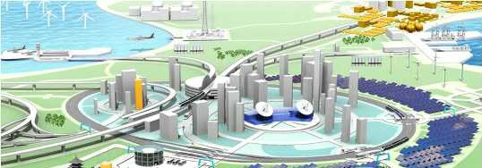


















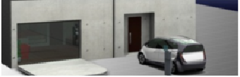
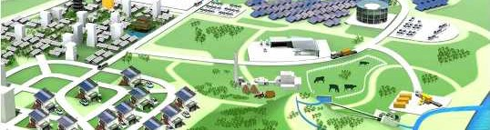





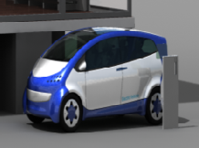











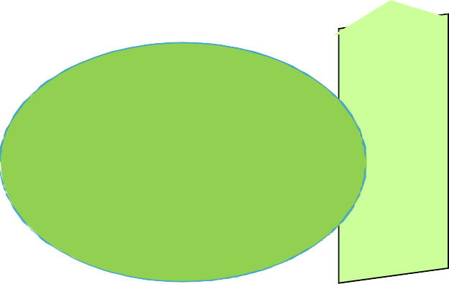
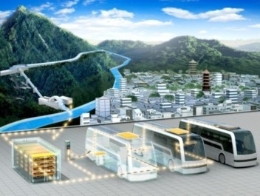











Integration of Various Functions in Smart Cities
Community Energy Management System for optimizing energy supply and demand
Nuclear Power Plant Thermal Power Plant
Power Line Free LRT
Smart Building
LRT with Battery
At the station: Charge to battery Between stations: Move by battery
Large Energy Storage
Wind Power
Utilize Electric Car
As a part of energy infrastructure
Utilize Natural Wind Flow
ITS
Control Center
LRT
Mega Solar
Quick Charging Station
Quick Charging Station
80% charge in 30 minutes
Shortage: EV → House Excess: House → EV
Electric Bus
Electric Car
Smart House
Micro Hydraulic Plant
Smart House
Electric Bus (works like LRT when connected)
Photovoltaic Cell
Battery Replaceable Bus / Works like LRT by connecting multiple buses
Dryer/Washer Dish Washer LED Light Television
Li-Ion Battery (Fixed)
AC Inverter
Smart Meter
Home Area Network
Motor
Li-Ion Battery (Replaceable)
Home Gateway
Air Conditioner
Heat Pump Water Heater
Elec
tric Car
Connected buses will operate like LRT
METI (2012)

Slide 7
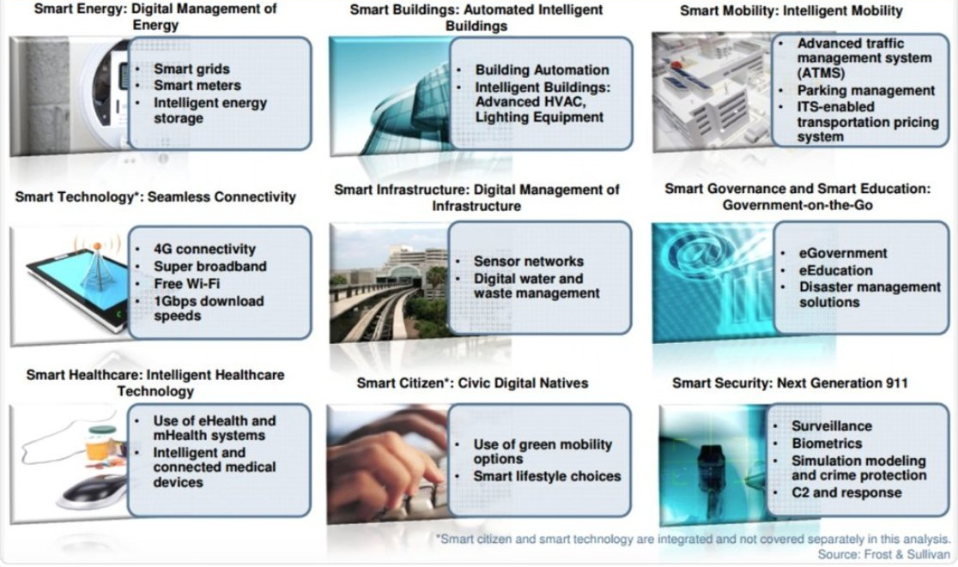
Key Components of Smart Cities

Slide 8


Slide 9
Societal Challenges Addressed in Smart Cities
Upgrading aging and deteriorating infrastructure for energy distribution
Reducing environmental burdens (CO₂ emissions, air pollution) by increasing renewable energy sources and efficient energy usage
Strengthening the resilience of the supply of energy and services against disruptions and disasters (earthquakes, typhoons, hurricanes)
Coping with cost pressure to improve energy efficiency and to cut back its consumption during peak periods

Slide 10
Technological Domains Related to Smart Cities
Information and Communication
  Grid control software; sensing, automation and control; communication infrastructure; conductor technology and approaches; load control and advanced metering infrastructure
Energy
  energy management systems, photovoltaics, energy storage, smart houses, electric vehicles, demand-response systems, distributed renewables, co-generation, district heating and cooling, energy-efficient lighting, advanced HVAC systems
Building and Housing
  New construction technologies and designs, life-course design and optimization, sensing and actuation for real-time space management, adaptive space design, financing, codes, and standards conducive to innovation
Transportation
  Multi-modal integration via ICT applications and models, On-demand digitally enabled transportation, Design for biking and walking, Electrification of motorized transportation, Autonomous vehicles
IEA (2010), President’s Council of Advisors on Science and Technology (2016)

Slide 11
Diversity in Creating Innovation for Smart Cities
Societal Challenges
Stakeholders
Technologies
Need to incorporate specific local conditions and contexts in policy making for smart cities

Slide 12
Elements of Innovation Systems
Knowledge and Technological Domains
  Specific knowledge base and specific technologies and inputs needed for research, production, and distribution
Actors and Networks
  Heterogeneous agents including firms, non-firm organizations (universities, financial organizations, industry associations) and individuals (consumers, entrepreneurs, scientists)
Institutions
  Norms, common habits, established practices, rules, laws, and standards, influencing the actions and interactions of actors producing and using knowledge
An innovation system undergoes processes of change and transformation through the co-evolution of its various elements.

Slide 13
Functions of Innovation Systems
Societal Guidance
Market Creation
Knowledge Creation and Diffusion
Creation of Legitimacy
Development of Positive Feedback
Innovation System
Entrepreneurial Activity
Resource Mobilization

Slide 14
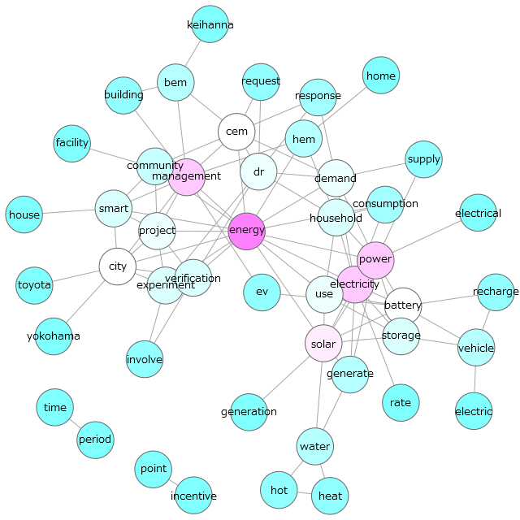
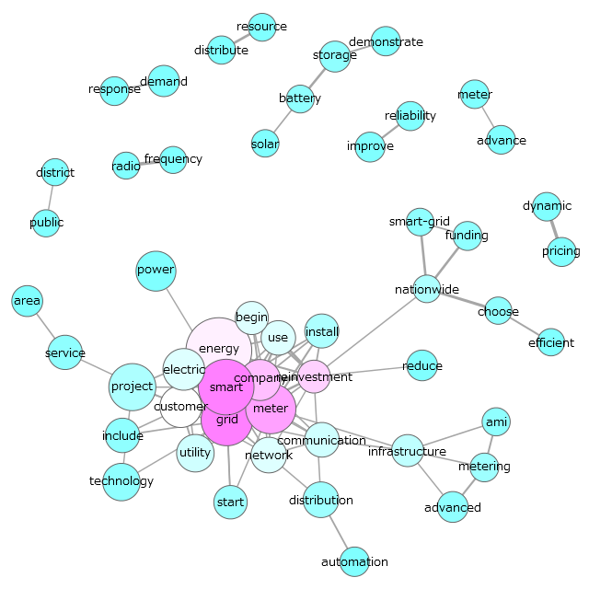
Knowledge and Technology Domains Concerning Smart Cities
Japan: PVs, distributed energy, and energy storage, home appliances, electric vehicles, community energy management
US: smart grid, smart meter technologies, communication network
Yarime and Karlsson (2018)

Slide 15
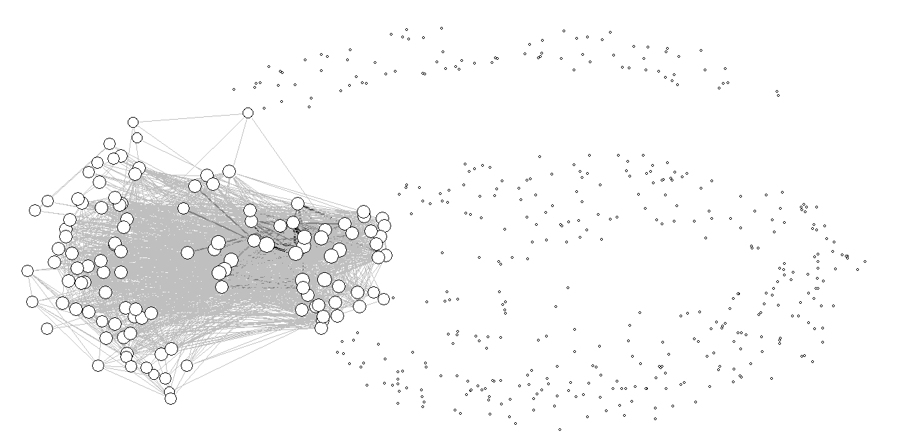
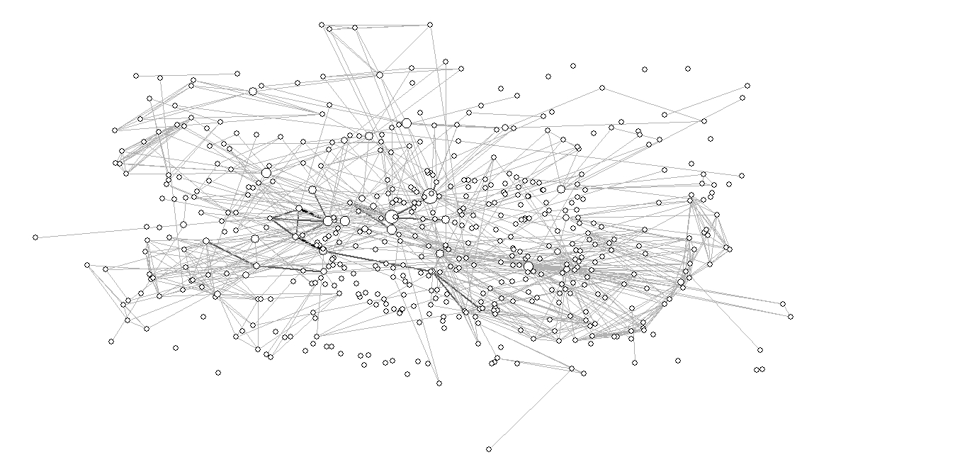
Network of Actors in Developing Smart Cities
Japan: concentrated structure dominated by a small number of large actors, e.g. energy & electric companies and public organizations
US: distributed structure with many actors, such as utilities and ICT companies including SMEs and start-ups
Yarime and Karlsson (2018)

Slide 16
Major Actors in Japanese Innovation System of Smart Cities
 | Type | Degree | ARD | Eigenvector | Betweenness
Hitachi | Electronics company | 74 | 303 | 0.173066 | 5212.703
TOSHIBA | Electronics company | 64 | 298 | 0.165316 | 3735.588
Mitsubishi Corporation | Trading company | 67 | 299.1667 | 0.171806 | 2908.344
NEDO | Governmental funding agency | 28 | 265.3333 | 0.044392 | 2735.742
Sharp | Consumer electronics company | 91 | 262.4989 | 0.243331 | 1603.521
Denso | Automotive component supplier | 55 | 293 | 0.174657 | 1567.229
Fuji Electric | Infrastructure vendor | 53 | 277.6672 | 0.141623 | 1516.667
JX Nippon Oil & Energy | Petroleum company | 55 | 293.5 | 0.166895 | 1481.08
Panasonic | Electronics company | 35 | 283.5 | 0.098062 | 1276.681
Furukawa Electric | Infrastructure vendor | 47 | 272.5004 | 0.132096 | 1187.081
University of Tokyo | University | 13 | 269.5 | 0.025997 | 1154.299
Sumitomo Electric Industries | Infrastructure vendor | 55 | 293.5 | 0.160089 | 1123.101
Urban Renaissance Agency | Real estate agency | 47 | 275.5005 | 0.123371 | 960.8317
TOTO | White ware vendor | 30 | 278 | 0.101322 | 917.3737
IBM | Software vendor | 30 | 278 | 0.101322 | 917.3737
Omron | Automotive component supplier | 24 | 275 | 0.061349 | 770.785
Kansai Electric Power Co | Electric utility | 24 | 275 | 0.061349 | 770.785
Iwatani | Gas equipment vendor | 29 | 263.3333 | 0.098677 | 658.7583
Nittetsu Elex | Infrastructure vendor | 29 | 263.3333 | 0.098677 | 658.7583
Tokyo Gas | Gas utility | 31 | 281.5 | 0.089186 | 609.8406

Slide 17
Major Actors in US Innovation System of Smart Cities
 | Type | Degree | ARD | Eigenvector | Betweenness
EPRI | Research institute | 28 | 194.8334 | 0.113018 | 7995.122
GE | Electronics company | 29 | 199.6667 | 0.122854 | 7513.267
Sensus | Meter vendor | 17 | 178.0835 | 0.048041 | 6957.279
Landis+Gyr | Meter vendor | 17 | 186.2501 | 0.086227 | 3986.014
Southern California Edison | Electric Utility | 16 | 181.8334 | 0.069304 | 3706.082
IBM | Software vendor | 26 | 189.8333 | 0.133678 | 3650.072
Pacific Gas & Electric Company | Electric utility | 15 | 143.1001 | 0.022026 | 3307.329
Premium Power | Infrastructure vendor | 8 | 135.2502 | 0.013672 | 3255.385
Aclara | Infrastructure vendor | 10 | 170.0001 | 0.049314 | 2633.994
Eaton | Infrastructure vendor | 12 | 175.3334 | 0.065682 | 2546.157
PJM Interconnection | RTO | 8 | 174.25 | 0.055321 | 2383.878
Itron | Meter vendor | 10 | 177.25 | 0.062162 | 1970.951
Navigant | Consultancy firm | 4 | 169.5833 | 0.051425 | 1970
Science Applications International | Infrastructure vendor | 8 | 105.0667 | 0.001076 | 1970
Oncor | Electric utility | 19 | 183.4167 | 0.12121 | 1877.981
DTE Energy | Electric utility | 2 | 165.5 | 0.041463 | 1749.594
Cooper Power Systems | Infrastructure vendor | 8 | 178.2501 | 0.07408 | 1740.068
American Electric Power | Electric utility | 18 | 188.5001 | 0.134307 | 1677.09
S&C Electric | Infrastructure vendor | 12 | 148.4667 | 0.038026 | 1660.706
Austin Energy | Electric utility | 8 | 138.0169 | 0.020919 | 1580

Slide 18
Innovation Systems of Smart Cities Driven by Energy Sector in Japan and ICT Sector in US
Japan
Strong interest in resilience to natural disasters and distributed energy systems
Focus on application technologies for home appliances and electric vehicles, energy storage, community management
Concentrated structure dominated by a small number of large actors, including government organizations and electric & electronic companies
Innovation system mainly driven by the energy sector
US
Strong interest in resilience to physical and cyber attacks and cost reduction
Focus on grid and smart meter technologies, communication, infrastructure network
Distributed structure with many actors, such as utilities and smart meter manufacturers including SMEs and start-ups
Innovation system mainly driven by the information and communication sector

Slide 19
Policies Influencing the Innovation System of Smart Cities
Reform of the energy market
Financial support for renewable energy sources
Participatory road-mapping on the development of key technologies
Demonstration projects through stakeholder collaboration
Standard setting for data exchange and communication through smart meters and devices
International implementation of smart cities

Slide 20
From Technological Development to Societal Experimentation
Traditionally support provided through the funding agency New Energy Development Organization (NEDO)
Prior to 2000: Development of individual technologies for introducing renewable energy to grid
2000-2010: Development and demonstration of multiple, large-scale technologies coordinated for introducing renewable energy sources to the grid
2010-: Experimentation of smart cities addressing societal needs and involving stakeholders

Slide 21
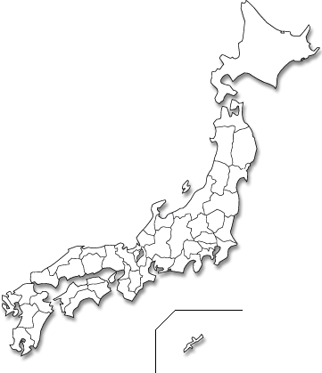
















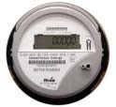


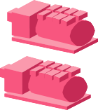





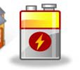
Local Differentiation of Demonstration Projects (2011-2015)
Keihanna Science City
Yokohama
Housing Complex
- Visualization of energy for control and management
- 700 households and HEMS
- Consulting business for energy saving
Wide‐Area Metropolis
- Large-scale introduction of renewable energy and electric vehicles
- 4,000 households and HEMS
- 10 large‐scale building
- Multiple storage batteries
BEMS.
Kitakyushu
Toyota City
Designated supply area
Separate housing
- Local production for local consumption
- 67 households equipped with solar panels, household fuel cells, storage batteries
- Advanced transportation system (EV, PHV)
- Optimization of various sources of energy
- Power supplied by Nippon Steel & Sumitomo Metal Corporation.
- Dynamic pricing system for 180 households
GE

Slide 22
Facilitating Technological Integration, Reliability, and Learning through Demonstration
Verifying emerging advanced technologies for smart cities increasingly connected and integrated (renewable energy, energy storage batteries, and energy management systems)
Exploring robust business models with active participation of relevant stakeholders, including local communities and residents
Large-scale adoption and intensive learning for the price of component technologies and the cost of operating energy systems to decline, encouraging their deployment in smart cities

Slide 23
Standard-Setting for Smart Meters and Equipment
Proprietary standards among competing providers having slowed down the market to take off
Open Automated Demand Response (OpenADR) 2.0 technology standard adopted following feasibility, interoperability and connectivity testing in the summer of 2013
With an application programming interface (API), the efficient development of applications facilitated, including HEMS and BEMS.
Adoption of HEMS driving Japan's smart household appliance industry, as LED lights, smart thermostats, plug-in electric vehicles, rooftop solar, demand-flexible water heaters, battery energy storage, and other appliances integrate with the IT network, with HEMS Alliance formed by leading companies to prepare a multi-vendor device environment
Various standards emerging rapidly for the Internet of Things (IoT) (e.g., ZigBee, Bluetooth Low Energy), leading to a need to consider coordination

Slide 24
Coordinating Various Functions of the Innovation System of Smart Cities
Research and Development
Stakeholder Consortia
Societal Guidance
Market Creation
Knowledge Creation & Diffusion
Creation of Legitimacy
Development of Positive Feedback
Innovation System
Entrepreneurial Activity
Resource Mobilization
Standard-Setting for Smart Devices
Government Targets & Initiatives
Disasters & Accidents
Public Funding
Start-ups & New Entrants
Economic Incentives to Renewables
Demonstration Projects
Involvement of Acaddmia, Citizens and Public Sector
Electricity Markt Reform
Yarime and Karlsson (2018)

Slide 25
Challenges in Facilitating Innovation for Smart Cities
Clear visions and matching with implementation
Strong leadership and transparency
Coordination among various standards in different fields and sectors
Serious and active participation of end users
Asymmetry of knowledge and expertise between large technology companies and local government and communities
Robust business models
Taking over the demonstration projects initiated with public funding by private actors
Human resources with skills and capacities to understand and integrate technical and social dimensions
Availability, accessibility, and ownership of data

Slide 26
Challenges in Open Data
What Incentives can be provided to various stakeholders for publishing and sharing data?
Who can have and how to control accessibility to data?
How to control the quality of the data?
Who owns the data and who can use it for what purposes?
  Increasing integration of data in various fields, including energy, transportation, housing, etc.
  Possibility of individual ownership of data and data portability

Slide 27
Policy for Open Data
Japan’s privacy law revised to introduce a concept of anonymously processed information to facilitate and legitimize business analytics and positive use of big data
The new change in privacy law allows organizations to process or transfer customer information after data being anonymized.
If customer identity details, including names, biometric information and government issued numbers, are all removed, no consent is basically required, whether the data is aggregate or not.

Slide 28
Coordination of Policy Making in Relevant Fields Concerning Smart Cities
Energy Policy
Environmental Policy
Science, Technology and Innovation Policy
Industrial and Competition Policy
International Trade and Investment Policy
Information and Data Policy

Slide 29
Policy Challenges in Developing Smart Cities
Regulatory Reform for Market Entry
  Start-ups and new entrants from different sectors
Institutional Design of Incentives
  Priority setting, economic mechanisms
Support for R&D and Entrepreneurship
  Increase in R&D expenditures, lean start-up
Implementation of Pilot Projects
  Trial and error through living laboratories
Open Data
  License conditions for utilities, transportation, and telecommunication companies on disclosure and use of customer data

Slide 30
Integrating Technologies and People
 | Smart City 1.0 | Smart City 2.0
Focus of Vision | Technology-driven, business-oriented | People-centered
Role of Citizens | Passive role as sensors, end-users/consumers | Active role as co-creators or contributors to innovation, problem solving and planning
Objective of Technology and Experimentation | Optimize infrastructures and services Serve user demands and spur new business opportunities Efficiency through ICT and big data | Solve social challenges Enhance citizen wellbeing and public services Legitimacy through participation and transparency in decision making and consensus building
Approach | Top-down, centralised | Bottom-up, decentralised, inclusive to diverse stakeholders
Cf. Crowley, Nutter et al. (2016), Nomura (2017), Trencher (2017)

