Slide 1
Touching millions of lives..
Partha Pratim
Senior Technology Consultant
iKure

Slide 2
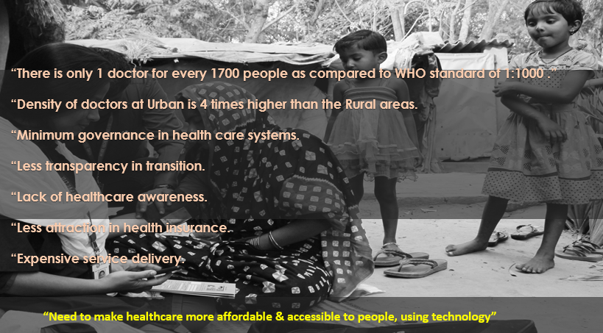

Challenges in Rural Healthcare Sector

Slide 3
About iKure
Working with 20 new alliances in India and technology
implementation partner in 5 Sub-Saharan countries
Serving 5.5 million beneficiaries,
across 2300 villages in
6 states in India.
Strong Partnership Ecosystem
Leveraging technology to bring
disruption in care delivery supported
through 4 hubs and multiple spokes
and network of community health workers.
Innovating for sustainable care through
annuity based health cards with
more than 4500 cards distributed

Slide 4
Why iKure ?
Expertise in designing of Baseline Framework
Experience in successful implementation and design of Methodical ANC framework* (monitoring and routine assessment)
Implemented Child health screening framework to identify early symptoms and patterns associated with developmental delays
01
02
03
Strong impact assessment framework design
Skilled and Dedicated Team of experts from different Domain working together.
04
05
*Design certified by University of Michigan

Slide 5
iKure’s Milestones
5.5M
Population Served
2,300 Villages
Covered
330
CHW
Trained
40,000
Health card Beneficiaries

Slide 6


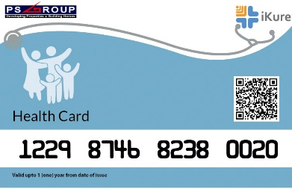



Current Offerings at our Tech Enabled Clinic
Blood Collection
At your Door step
Mother & child Care
Physical Consultation
Telemedicine Service
Medicines
Digitized Health Card

Slide 7





Current Offerings at our Tech Enabled Clinic
Eye Check-up
Ambulance Services
Physiotherapy
Dental Check-up
Awareness on Govt. schemes

Slide 8
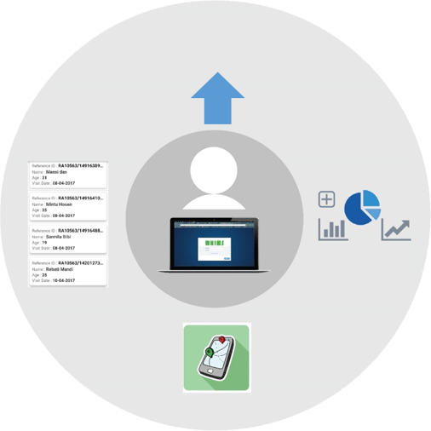
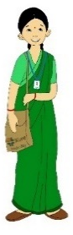
Technology Flow Diagram - CHW
Cloud
Clinic
Admin
Health Card
Complete Patient details
GPS tracking & monitoring
Dashboard & MIS report
Comparative Graphs
Dashboard
&
MIS Reports
Patient Details
GPS tracking & monitoring
Patients
CHW

Slide 9



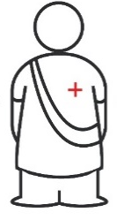
Transformation of CHW: Adoption of Technology
Learnings
Effective management of healthcare
data using technology
Real-time technology driven health
intervention reduces TAT.
Generating analytical reports
Health worker enabled supply chain framework can able to address the basic primary healthcare needs
MCH
Diabetic Retinopathy
Supply Chain
Device Integration
Routine check up
High risk pregnancy
detection
Developmental delay
detection among children
Routine check up
Awareness KAP
Ophthalmic History
Early stage detection
Heterogeneous
approach
Offline module
Procurement process
Sales process
Integration with POC
devices
Bluetooth devices
Biometric integration
BI tool integration

Slide 10





Our Collaborations
Data analysis & research
Device Integration
WEF
ANDE
IIH, Washington
Govt. (Central & State)
IIM
TATA Trust, DF
Neuvola
Braveheart
Philips
Morphometrix
GE
Hemocue
Aerotel
Duke
MIT
University of
Michigan
CHMI
Data
Amazon
Google
Microsoft
Power BI
Data
Data
WEF: World Economic Forum
ANDE: Aspen Network of Development Entrepreneurs
IIH: Innovation in Healthcare
DF: Deshpande Foundation
CHW travelling to patients home
Data on Cloud
Network Forum

Slide 11
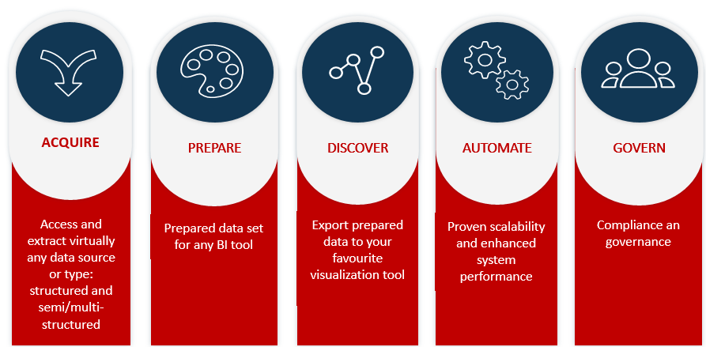
Solutions for existing Healthcare Providers

Slide 12
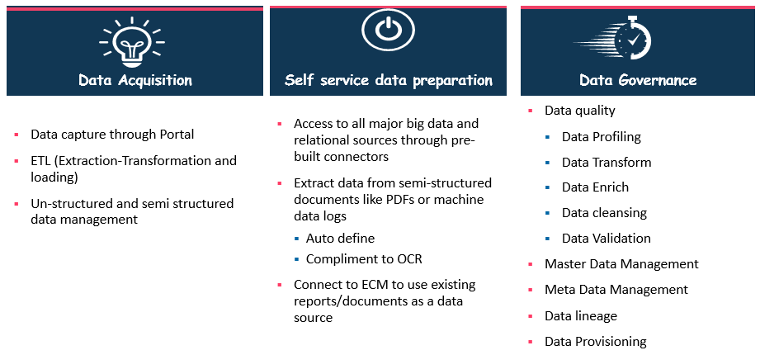
iKure’s offering for Information Management

Slide 13
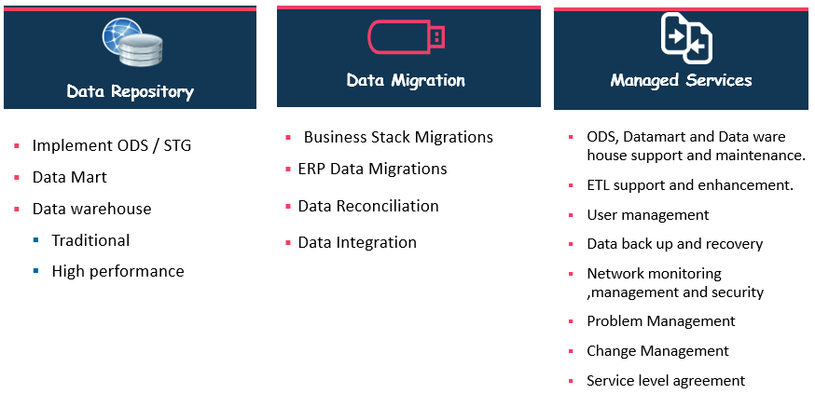
iKure’s offering for Information Management

Slide 14
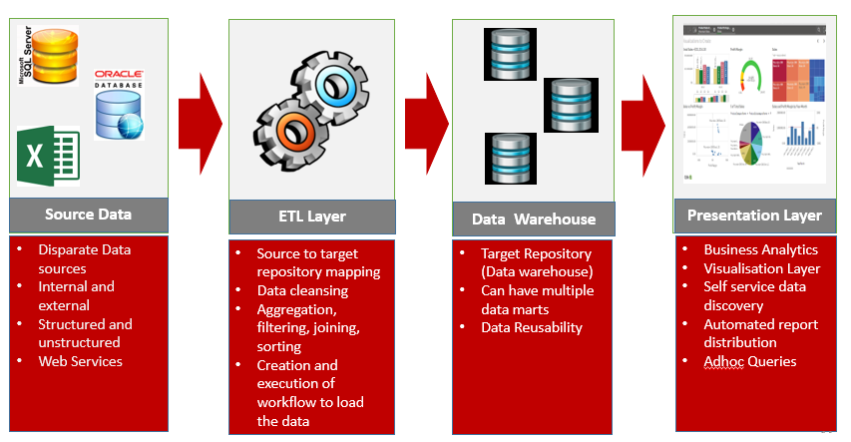
Data warehouse , BI & Predictive analytics

Slide 15
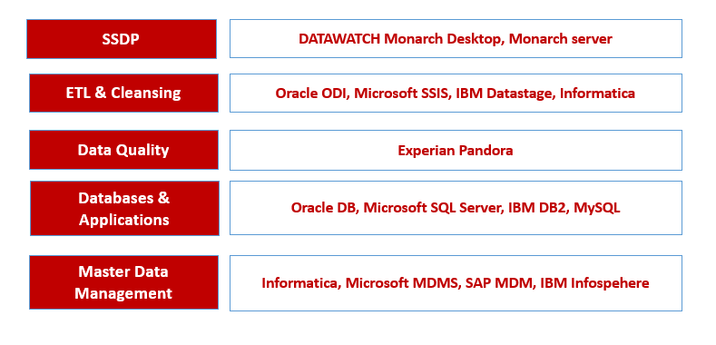
Our Technology Strength

Slide 16
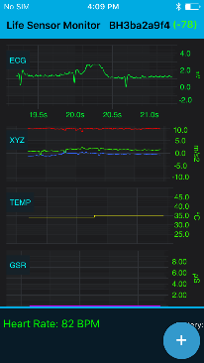
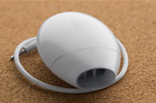
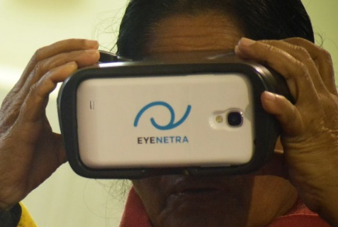
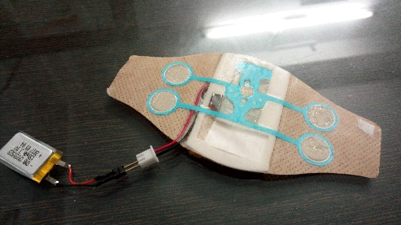
Upcoming Updates in device integration
Portable ECG Patch
Asthma Device
Self Refractometer
To provide access to constant monitoring and screening of heart stroke and other heart ailments.
Everyday-wear package
Parameters can be monitored and captured at the last mile
Provides access to EKG data information instantly.
To measure lung function instantly.
Can be used by people with Asthma, COPD, Cystic Fibrosis, Alpha–1, or any other respiratory condition.
proactive management of asthma.
To Capture Refraction error at the last mile
Immediate results which can be mailed to the patients.
Portable and easy to carry
Accurate Results

Slide 17
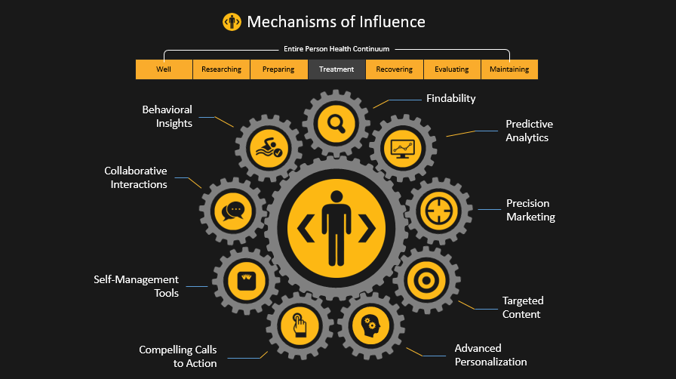
Transforming Rural Health Using AI & ML

Slide 18
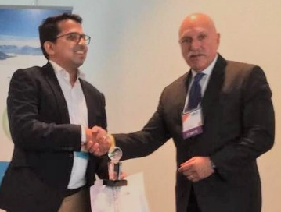
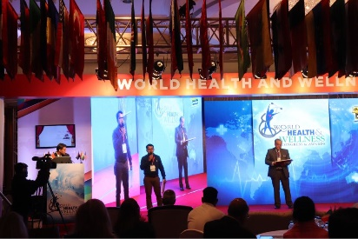
Awards and Recognitions
iKure wins the first position in the Global Sourcing Council’s 3S Award in the category ‘Innovation Via Technology’
Elated to win the international mBillionth-South Asia award 2016
Sujay Santra & iKure received appreciation from his excellency President of India for being a Ashoka changemaker
Last Mile Healthcare Providers
Sujay Santra chosen as one of the 100 most impactful healthcare leaders (Global Listing)
iKure selected as one of the top 8 participants in the world for Ashoka Globalizer event in partnership with Philips Foundation & Mckinsey International.
iKure received the NDTV Awards -- Good Samaritan of the Year 2016

Slide 19

THANK YOU

