Slide 1

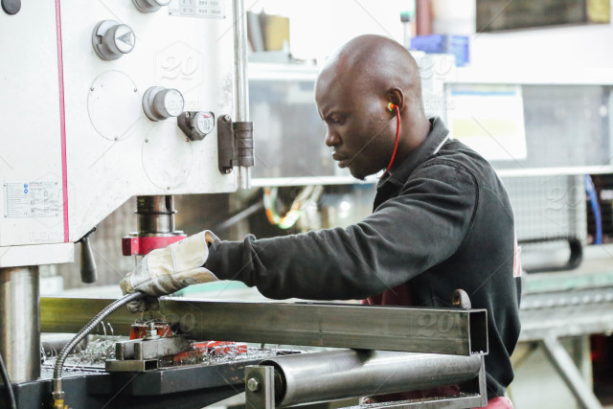
Digitalisation and the future of manufacturing in Africa
ICT for Manufacturing
Development
in Africa
By: Ms. Bineswaree (Aruna) Bolaky
Economic Affairs Officer
United Nations Conference on Trade and Development (UNCTAD)
New Delhi, 23 March 2018
Note: All photos are from Pexels.

Slide 2
Structure of presentation
State of manufacturing in Africa and the challenge of competitiveness
Digitalisation and its implications for African manufacturing
  Leveraging ICT-based services for traditional manufacturing
  Some thoughts on digital manufacturing based on UNCTAD’s work
Policy recommendations from UNCTAD
Sources: UNCTAD publications, World Economic Forum et al Africa Competitiveness Reports

Slide 3
State of manufacturing in Africa
Economic Development in Africa Report 2011 (UNCTAD)
The contribution of manufacturing to GDP peaked in 1990 and fell thereafter
Africa accounts for a vey low share of global manufacturing
Manufacturing is small relative to other developing country regions and has been falling both as a share of GDP and exports
Africa is losing ground in labor intensive manufacturing sectors
Africa is heavily dependent on resource-based manufactures
African manufacturing is dominated by small firms that have weak technological capabilities
Informality is a feature of African manufacturing

Slide 4
Source. UNIDO Industrial Development Report 2016

Slide 5
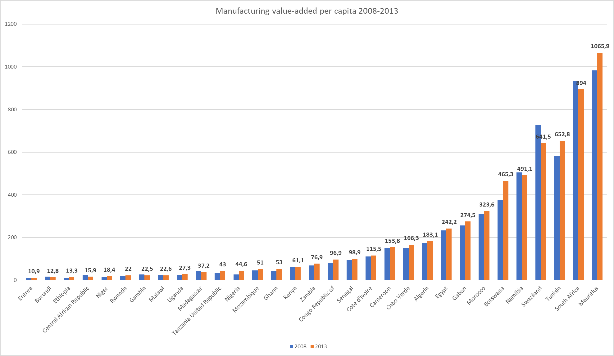
Source. UNIDO Industrial Development Report 2016

Slide 6
Source. UNIDO Industrial Development Report 2016

Slide 7
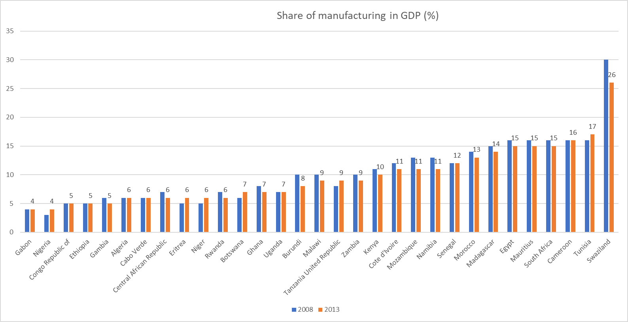
Premature de-industrialisation-falling share of mfg in GDP: Gambia, Central African Republic, Rwanda, Ghana, Burundi, Malawi, Zambia, Kenya, Cote d’Ivoire, Mozambique, Namibia, Morocco, Madagascar, Mauritius, Egypt, Swaziland (16 out of 31 countries for which data are available from UNIDO IDR 2016)

Slide 8
State of manufacturing in Africa: the challenge of competitiveness
According to Africa Competitiveness Report 2017
  The development of transport and energy infrastructure has stagnated, widening the gap with advanced economies and developing Asia.
  technological readiness (especially mobile phone penetration) is one of the areas where Africa has improved the most in absolute terms
  Access to mobile-phone technology has equipped millions of Africans with new tools for managing their businesses and households
Regional integration: a launchpad for Africa’s manufacturing sector but….
Huge infrastructure (hard and soft) deficits in Africa: access to energy, water, ICT, financial services, significant rural-urban divide
Costs of production are higher in Africa than other parts of the developing world (Benchmarking Africa’s costs and competitiveness, Africa Competitiveness Report 2009)
  Firms in Africa are almost 20 percent less competitive than firms in the other regions, although considerable variation exists across countries
Question: How can ICT help to relieve the costs that these infrastructure bottlenecks impose on the manufacturing sector in Africa in terms of lost competitiveness /productivity? How can ICT impact on the multiple drivers of manufacturing competitiveness?

Slide 9
State of manufacturing in Africa: the challenge of competitiveness
ICT to increase labor productivity in mfg
ICT to complement physical capital and raise productivity of physical capital
Source. AfDB/World Bank/WEF Africa Competitiveness Report 2017

Slide 10
Digitalisation and its implications on manufacturing in Africa: Leveraging ICT-based services for traditional manufacturing
Direct Costs
Indirect costs
Invisible costs
Capital
Labor
Electricity
Transport
Electricity (fuel generators)
Telecommunications
Regulatory requirements
Capital
Electricity (losses from power interruptions)
Transport (transport delays)
Regulations
Corruption
Security

Slide 11
Leveraging ICT-based services for traditional manufacturing
Economic Development in Africa Report 2015
During the periods 2001–2004 and 2009–2012, of the 45 African countries where the share of services in output rose, 30 experienced a contraction in manufacturing.
The international competitiveness of African manufacturers is negatively impacted by high indirect costs related to infrastructure services.
Complementarity between services and manufacturing: services and ICT-based services as an enabler of manufacturing development in Africa

Slide 12
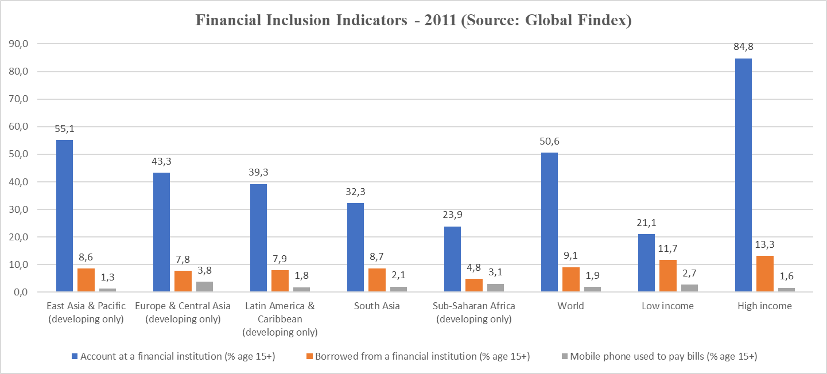
Leveraging ICT-based services for traditional manufacturing competitiveness
Example 1 : ICT-based financial services to improve financial inclusion, digitization of payments and promote entrepreneurship
  Access to formal financial services is only 24 per cent in SSA
Notes:
In Kenya today, according to Vodafone (owner of 40 percent of Safaricom), M-PESA has 19 million users transacting Ksh 15 billion (about $150 million) daily These transactions are dominated by domestic money transfers, but also include paying merchants via Lipa Na MPESA6 , using a combined savings-and-loan product called M-Shwari7 , and most recently, managing accounts at commercial banks.
Equity Bank's mobile banking platform is Equitel, and Equitel's core product is Airtel Money, a mobile commerce service that was actually launched in September 2011 and competes directly with M-PESA (Rosengaard, 2016).
Equity Bank's mobile banking platform is Equitel, and Equitel's core product is Airtel Money, a mobile commerce service that was actually launched in September 2011 and competes directly with M-PESA. Airtel Money is available to all Equity Bank account holders for: mobile phone airtime top-up; payment of utility bills and purchase of goods and services from merchants; and Equity Bank account access and management. Other Equitel products are: Eazzy 247, a mobile banking service that provides Equity Bank account access via all MNOs, including Safaricom; and MKesho, a bank account that allows funds transfer between it and the M-PESA system of deposits and withdrawal

Slide 13

Leveraging ICT-based services for traditional manufacturing competitiveness
Example 1 : ICT-based financial services to improve financial inclusion, digitization of payments and promote entrepreneurship
  Mobile phone banking allows countries to immediately bring financial services to the masses in a cheap, accessible way, especially in rural areas and marginalized groups
  Success since 2007 of Safaricom’s M-PESA, literally “mobile money,” a mobile phone-based money transfer, payment, and banking service
  Rise of bank-led mobile banking model spearheaded by Equity Bank (Airtel Money).

Slide 14
Leveraging ICT-based services for traditional manufacturing
Example 2: ICT to cut red tape and improve regulatory governance, reduce invisible costs of production
  E-regulations and e-registrations programme of UNCTAD
    Reduce transaction costs
    Improve compliance with taxes
    Improve business climate and attract investments in manufacturing
UNCTAD e-regulations programme
  Mali
  Burkina Faso
  Togo
  Benin
  Cameroon
  Ethiopia
  Rwanda (in progress)
  Comoros (in progress)
  Cabo Verde(in progress)
  Morocco(in progress)

Slide 15
Leveraging ICT-based services for traditional manufacturing
Example 3: ICT and trade and transport facilitation systems
  Role in fostering trade across borders and regional integration that can open up markets for manufactured goods
  ASYCUDA (World and ++) programme of UNCTAD
    Customs IT system
    Improve efficiency and government revenues
    Enhance transparency and accountability
    Installed with UNCTAD TA in 43 African countries
ESCAP ICT for trade and transport facilitation
Areas of trade and transport facilitation where new IT business needs emerge
Risk management
Transit facilitation, and Guarantee management (for transit),
Licenses, certificates and quota management,
Coordinated Border Management,
Transparency/administrative facilitation,
Customs processing,
Decision-making support systems,
Cross-border exchange of information.
Notes:
ASYCUDA is a computerized customs management system which covers most foreign trade procedures. The system handles manifests and customs declarations, accounting procedures, and warehousing manifest and suspense procedures. It generates detailed information about foreign trade transactions which can be used for economic analysis and planning. Steps are now being taken to prepare the necessary software to include transit procedures.
Trade and transport facilitation require governments, administrations and businesses to improve efficiency and effectiveness, to simplify, standardize and harmonize processes, documents and formalities, to foster partnership and cooperation, and to increase transparency. Information and Communications Technology (ICT) can support many trade and transport facilitation concepts and objectives. The value of ICT for trade and transport facilitation goes beyond concepts such as Single Windows. Automated business processes, digitalization of procedures, simpler interaction and transmission of data, and faster decision-making abilities deliver advantages in many trade and transport facilitation areas.
Large ICT systems that focus on automation of frequently used and standardized business processes, such as customs clearance, are no longer sufficient. More business processes and government services need to be automated or digitalized, and cooperation through sharing information and processes needs to be supported. The table below shows selected implementation areas of trade and transport facilitation where new IT business needs emerge. These areas are: • Risk management • Transit facilitation, and Guarantee management (for transit), • Licenses, certificates and quota management, • Coordinated Border Management, • Transparency/administrative facilitation, • Customs processing, • Decision-making support systems, • Cross-border exchange of information.

Slide 16
Leveraging ICT-based services for traditional manufacturing
Example 4: ICT and the exploitation of the potential of e-commerce
UNCTAD ICT Policy Reviews
  ICT Policy Review for Egypt
  National e-commerce strategy for Egypt

Slide 18
Leveraging ICT-based services for traditional manufacturing
Rise in the use of digital services (Computer programing & Information Services and Telecommunication services) in the production of manufactured products and in the value added contributed by digital services (DS) in exports of manufactured products in developed countries
Digital services as a source of competitiveness
Source: South-South digital cooperation for industrialization: A regional integration agenda, UNCTAD March 2018

Slide 19
Source: South-South digital cooperation for industrialization: A regional integration agenda, UNCTAD March 2018

Slide 20
Some thoughts on digital manufacturing UNCTAD 2018
WTO moratorium of zero customs duties on Electronic Transmission (ET) products will make developing countries lose trade competitiveness even more…
With additive (3D) manufacturing, more products will become digitalized …list of future ET products unknown…tariff revenues in developing countries will fall while disrupting their industrial policies
Developing countries must preserve policy space at WTO

Slide 21
Policy recommendations UNCTAD
10 point agenda for South-South digital cooperation within regional blocs
i. Building a Data Economy.
ii. Building Cloud Computing Infrastructure
iii. Strengthening Broadband Infrastructure
iv. Promoting E-Commerce in the Region
v. Promoting Regional Digital Payments
vi. Progressing on Single Digital Market in the Region.
vii. Sharing Experiences on E-Government.
viii. Forging partnerships for building Smart Cities
ix. Promoting Digital Innovations and Technologies
x. Building Statistics for measuring Digitization
Foster the formulation and implementation of digital industrialization strategies in developing countries, including Africa, especially as part of regional integration processes
Developing countries must develop their national e-commerce sectors through digital industrialisation policies
To do so, must preserve policy space at the WTO
South-South cooperation, in the form of regional digital cooperation, is essential for digital industrialization of the South

