Slide 1
Disruptive Innovation & Defence Industry
Shuktij Singh Rao

Slide 2
Contents
Disruptive Innovation
The Business of Defence
Disruptive Innovation in Defence Industry
Extent of impact on other industries
Factors that impact Disruptive Innovation
The state as an entrepreneur
The case of Indian defence Industry

Slide 3
Disruptive Innovation
Beyond routine instances of innovation
Beyond innovations in product, process & service.
Industry changing phenomenon
Disruptive Innovation needs leaders with special skills
Needs tinkering with business models, value propositions, sales models etc

Slide 4
The Business of defence
Different from conventional businesses
Heavily regulated
Stiff entry barriers
Users and Buyers are separate entities
At the forefront of innovation
Largest investments in Disruptive R&D
Globally defence companies are adopting disruptive technologies.

Slide 5
Disruptive Innovation in Defence
Disruptive Innovation is one of the major key strategic themes in defence industry
In Defence industry, disruption is sought in military supremacy unlike other industries where only commercial success measures disruptive innovation.
Highly expensive, sophisticated and commercially unfit innovations create disruptions in military supremacy.

Slide 6
Disruptive Tech in Defence
IoT enables predictive analytics which is changing the monitoring & mmaintenance of military equipment
Cloud enables data rich interactions between customers & development teams
3D printing in prototyping military technology
Augmented Reality & Virtual reality
Every emerging disruptive technology in use

Slide 7
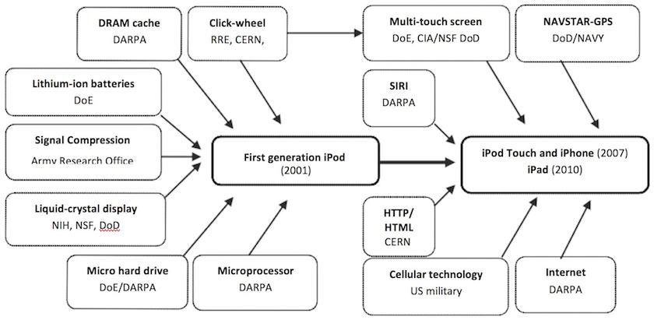
How The US Military Is Responsible For Almost All The Technology In Your iPhone
Mazzucato, M.(2013) The Entrepreneurial State: Debunking the Public vs. Private Sector Myths. London: Anthem
Notes:
This Chart Shows How The US Military Is Responsible For Almost All The Technology In Your iPhone
Nearly all of the technology in many of the world's most ubiquitous electronic devices can be traced to a single, taxpayer-funded source: the US Department of Defense.
In an article promoted by the European Commission today, Italian economist Mariana Mazzucato wrote that sparking the world's economies after a long recession will require greater and riskier investment from government. She used Apple's wildly popular handheld devices as a present-day example.
The world's biggest company may have more cash on hand than many actual governments. But the technological breakthroughs behind its iconic iPods, iPhones, and iPads were funded almost exclusively by government agencies - and by one particular segment of one particular country's government.
As the chart below demonstrates, there's little in these devices that doesn't owe its existence to the US Department of Defense in some form or another Later devices saw investments from the Navy for their GPS capabilities, and the Defense Advanced Research Projects Agency (DARPA) funded Siri. In fact, the parent company of Siri's creator, which was acquired by Apple in 2010, still gets over half of its revenue from the Department of Defense, according to a report they published earlier this year.
Highlighting an idea from her recent book on the relationship between the private and public sectors, Mazzucato explains that achieving missions like putting a man on the moon required "a confident 'entrepreneurial state' willing and able to take on the early, capital-intensive high risk areas which the private sector tends to fear."
The US military was often the one taking "capital-intensive risks" that resulted in Apple's line of products. And the result is a family of devices so widely used that it's difficult to imagine the world without them.

Slide 8
Factors that impact Disruptive Innovation in Industry
Speed of change
Non Market Forces
Competitive rivalries
Strategic choices

Slide 10
The state as Entrepreneur
Defence business is most often Government to government (G2G)
Almost all examples of disruptive innovation in defence are fuelled by intense government-industry-academia interactions
Defence Industrial base (DIB)

Slide 11
The case of Indian Defence Industry
Flat growth across the globe is in contrast with strong YoY growth of defence expenditure in India.
High potential of supply chain value addition by ‘Make in India’.
Large DIB
Crucible of Innovation?

Slide 12
Thanks a lot!

