Slide 1
Decent Jobs for Youth
ACTIVE LABOUR MARKET PROGRAMMES
Interventions to improve the labour market outcomes of youth: systematic review
March 2018

Slide 2
overview
1.
2.
3.
The challenge
The Global Initiative on Decent Jobs for Youth
Systematic Review on ALMPs
Notes:
Young people face a difficult process in seeking to enter the WORLD of WORK
Economic dynamics – emerging technologies – competitiveness – and human capital development through education and skills should be updated in terms of changing labour market dynamics.
We must not miss the fact that what happens to the youth as they enter the labour market is very much dependent on what is happening to what is happening in the economy as a whole.
A lesson for this was when the global recession left its mark – after falling unemployment rates, it once again saw increases.

Slide 3
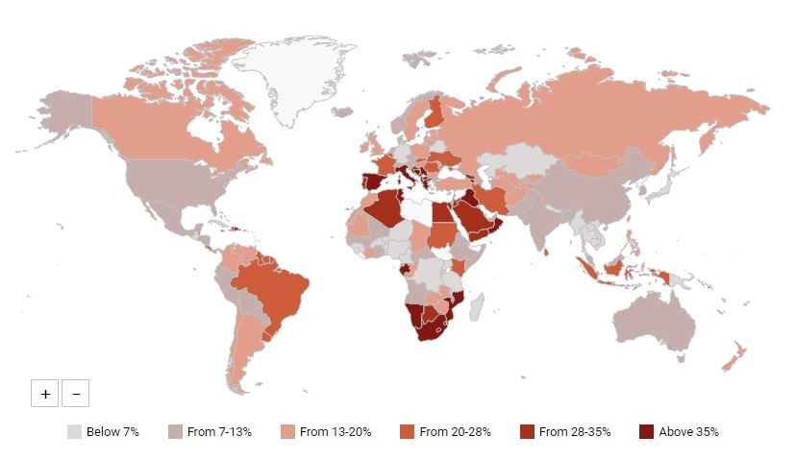
71 million youth are currently unemployed
The percentage of youth aged 15-24 looking for, but unable to find work
Notes:
Globally, youth unemployment is high despite improving levels of education.
2016 and 2017 unemployment rates around the world are of 13.1%
Aprox 70 million of youth are seeking and are unable to access to jobs, but this maybe the tip of the iceberg: quality jobs is now a major concern.
In LMIC it is common for young to be employed in vulnerable or informal jobs (where no contractual arrangements or job security exists).
In HIC we find them more in temporary or non standard forms of employment:
In OECD 15-24 → 25% and for the ages of 25-54 → 9.5%
In EU 15-24 → 44% and for the ages of 25-54 → 12.3%
Challenges has become more difficult in promotion of employment of youth and this will vary widely depending across national and regional context, as well as the characteristics of young people themselves.

Slide 4
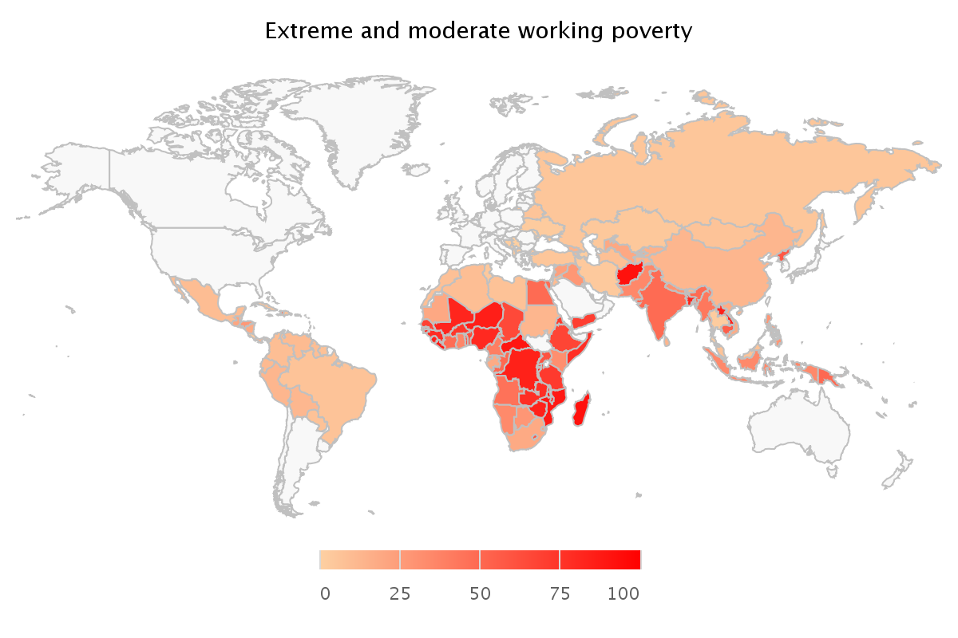
In emerging and developing countries over 152 million youth live in poverty despite being employed
Poverty Rates Among Youth Workers (%)
Extreme and moderate working poverty (<$3.10 PPP per capita per day)
Notes:
What-is-more 152.2 million youth are estimated to work in 2017, yet live in poverty. This means that slightly more than 2 in every 5 young people in the workforce are without work or working but poor.
UN standard definition of what is considered a young person is that in the age of 15-24. Nevertheless nowadays young people tend to stay in education in higher levels extending the transition to the labour market.
In ILOs School to Work Transition survey 2015, in LMIC 1 out of 3 young men and 1 out of 2 young women between the ages of 25-29 are not working either because they were in education or training or they were neither in employment, nor education nor training (NEET).
So what are the mechanisms that are there for promotion youth employment, and what can be the outcomes?

Slide 5
Active LaboUr Market Interventions
TRAINING AND SKILLS DEVELOPMENT
Lack of formal education in many countries → improve basic skills and employability
ENTREPRENEURSHIP PROMOTION
Provide entrepreneurial skills as well as physical, financial and social capital for self-employment
EMPLOYMENT SERVICES
Job-search assistance, mentoring; often complemented by job placement services
SUBSIDIZED EMPLOYMENT
Wage subsidies, public works → provide short-term employment and on-the-job experience
→ Distinguish program and intervention level in analysis
Notes:
Labour market interventions : ALMPs
Are typically public funded programmes which aim to provide employment prospects of participants. (Exclude unemployment insurance schemes and non-conditional transfers)
Programs aimed at the improvement of the beneficiaries’ prospect of finding gainful employment or earnings capacity
require active participation in programs (difference to e.g. unemployment insurance schemes)
Empl. Services: play a mediation role between job seekers and firms seeking workers.
efficiency of search, nudging + job matching
job counselling, job search assistance, and/or mentoring
Job search efficiency, matching
Subs. Employ: Employment on public projects (PEPs) such as infrastructure construction, socially useful job. Or employment for private firms via wage subsidized.
reduce the labour cost for employers
private sector employment incentives
Provide job experience
employer/worker behavior
Training in Skills: Typically involves training on and off the job, providing job-related skills.
skills mismatch, Raise human capital
Entrepreneurship promotion: managerial skills, capital and investment, to create and enhance businesses

Slide 6
Active LaboUr Market Interventions
TRAINING AND SKILLS DEVELOPMENT
Lack of formal education in many countries → improve basic skills and employability
ENTREPRENEURSHIP PROMOTION
Provide entrepreneurial skills as well as physical, financial and social capital for self-employment
EMPLOYMENT SERVICES
Job-search assistance, mentoring; often complemented by job placement services
SUBSIDIZED EMPLOYMENT
Wage subsidies, public works → provide short-term employment and on-the-job experience
→ Distinguish program and intervention level in analysis
Notes:
Different programs serve different purposes or functions; although evaluation is usually done under the same criteria. Purposes go from increase participants skills, increase employability, creating new short term employment opportunities, providing inmediate income support, increasing chances of finding employment in the long term or business profitability or sales. Increasing wages/income in the long term.
Combinations
Single program, multiple interventions
single programme may have different tracks – one track providing job placement services and another providing skills training
Interest not in programs, but interventions: types are evaluated separately in the meta-analysis
defined based on their characteristics such as the category of intervention or the population targeted
each intervention within a programme has separate groups of participants which do not overlap

Slide 7
overview
1.
2.
3.
The challenge
The Global Initiative on Decent Jobs for Youth
Systematic Review on ALMPs

Slide 8

Strategy and Launch of Decent Jobs for Youth
Decent Jobs for Youth emerged as the first-ever, comprehensive United Nations system-wide effort for the promotion of youth employment worldwide.
Notes:
In response to the youth employment challenge, Decent Jobs for Youth was launched in February 2016 under the auspices of the ECOSOC Youth Forum in New York.
Decent Jobs for Youth emerged as the first-ever, comprehensive United Nations system-wide effort for the promotion of youth employment worldwide. The strategy for Decent Jobs for Youth was developed by the High-level Committee on Programmes under the leadership of the International Labour Organization (ILO), and subsequently endorsed by the UN system Chief Executives Board for Coordination. Twenty-two entities and agencies of the UN System have influenced the design of Decent Jobs for Youth and expressed alignment and support to its expansion and operationalization.
Decent Jobs for Youth seeks to maximize the effectiveness of youth employment investments and to assist in delivering on the 2030 Agenda for Sustainable Development.

Slide 9
Strategic elements
St
St
St
St
ALLIANCE
ACTION
KNOWLEDGE
RESOURCES
for political mobilization, policy coherence, and high level advocacy
to expand investments and impact at regional and country levels
for evidence-based action, greater innovation, capacity development, and peer learning
both local and international to enable scaling up activities and impact
The goal is to scale up action at the country-level and to increase impact through effective, innovative and evidence-based interventions
Notes:
1, Strategic Alliance Building. It relies on a Strategic Multi-stakeholder Alliance to advocate, ensure policy convergence, stimulate innovative thinking and mobilize resource for more and better investments in youth employment. The Alliance welcomes organizations across a wide spectrum of groups.
2, Action at regional and country levels. We must scale up action, ensure ownership and coherence with national development priorities and tailor our activities, based on evidence of what works in different settings. This work will rely on the commitment of regional institutions and the support of UNCTs to fully engage a diverse set of national and local partners.
3, Improved Knowledge about What Works. It will set up a global Knowledge Facility to capture, analyse and widely share best practices and innovation, enhance capacity development and facilitate peer learning about what works to improve labour market outcomes for young women and men.
4, Innovative and sustainable funding modalities and resource mobilization. It will advocate for high level commitment of local and international actors to increase resources through present and future funding facilities to enable scaling up activities in the most inclusive and transparent manner.

Slide 10
Multi-stakeholder alliance |Going beyond the UN system
Governments
Private sector
United Nations System
Regional & multilateral organizations
Parliamentarians
Social partners
Media
Foundations
Academia
Youth organizations & civil society
Notes:
It will be comprised of governments, private sector, youth organizations and civil society, social partners, the UN System, regional and other multilateral organizations, parliamentarians, foundations, the academia, and the media.

Slide 11
Thematic priorities | concrete action
Skills including digital skills and quality apprenticeships
Youth in the informal economy
Green jobs for youth
Decent work for youth (15-17) in hazardous occupations
Youth in fragile situations
Youth in the rural economy
Youth entrepreneurship and self-employment
Innovation
Evidence
Opportunities
Priorities
Alliances
Action
Notes:
Our actions will be concrete.
We will focus on:
green jobs for youth;
quality apprenticeships; digital skills and the building of “tech-hubs”;
support young people in the rural economy;
facilitate transition from the informal to the formal economy;
youth entrepreneurship.
We will also target disadvantaged youth for example:
those workers, age 15 to 17, who are in hazardous occupations, or
those in fragile states affected by conflict and instability.
Building on innovative approaches and state of the art knowledge and evidence;
Capitalizing on existing resources, ongoing initiatives and other opportunities;
Maintaining perspective of priority regions, countries, youth groups (disadvantaged, young women, migrants);
To expand alliances, enhance collaboration, and
Ultimately scale up action and impact

Slide 12
overview
1.
2.
3.
The challenge
The Global Initiative on Decent Jobs for Youth
Systematic Review on ALMPs

Slide 13
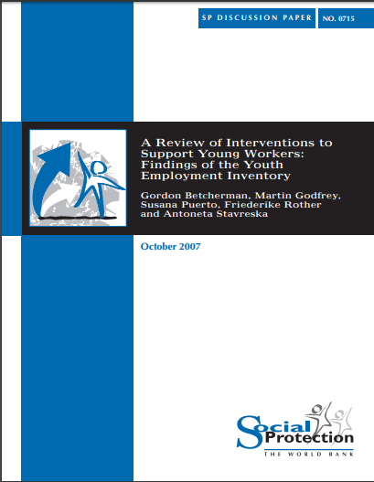
Systematic review of youth employment interventions
Large demand
Growing evidence base (esp. LMIC)
Not all research is of equal value/quality
Single studies can misrepresent the balance of evidence
Synthesize evidence!
Notes:
Large demand for
Growing evidence base (esp. LMIC)
Not all research is of equal value/quality
Single studies can misrepresent the balance of evidence
Synthesize evidence!
Existing reviews on youth employment are either not systematic, not youth focused, analyse a limited set of studies, or do not use empirical methods.
Key components of this systematic review:
Transparent and replicable: peer-reviewed protocol publicly available
Clear theory of change underlying the review question
Comprehensive search, incl. grey literature
Explicit study inclusion and exclusion criteria
Coding of study characteristics and empirical results
Quantitative and qualitative synthesis

Slide 14
The review focus
Question | What is the impact of youth employment interventions on labour market outcomes of youth?
Inclusion | Counterfactual impact evaluations Youth (15-35) targeted Active Labour Market Programmes Skills training, entrepreneurship promotion, employment services, subsidized employment. 1990 – 2014 timeframe Labour Market Outcomes: Employment, Earnings, Business performance
Notes:
Research Questions
What is the impact of youth employment interventions on labour market outcomes of youth?
Which type of interventions are the most effective?
What is the role of context and programme design?
Inclusion:
The review includes impact evaluations that rely on a counterfactual to assess changes in outcomes.
These impact evaluations should focus on ALMPs for youth, understanding youth as a target group of age 15 to 35.
The timeframe for these impact evaluations is 1990 – 2014
The ALMPs behind the studies should fall under the following categories of interventions: ST, EP, ES, and SE
And the studies should provide measures of impacts across the following clusters of outcomes: Employment, Earnings and Business performance.
These outcomes cover a range of different measures. Emp: prob of employment or unemployment, hours of work; Earnings: wages; Business performance: profits, sales.

Slide 15


Programmes at a glance
COLOMBIA
DOMINICAN REPUBLIC
UGANDA
MALAWI
Life + vocational skills to adolescent girls
Apprenticeship training (TVET) + pep talks to vulnerable youth
Life + vocational skills / Classroom + on-the-job to youth NEET
Impacts:
↑ Prob. of employment and starting a business.
Positive on consumption
Channels:
↑ Financial & analytical skills.
Impacts:
No impact on earnings
Negative on business creation
Channels:
↑ Skills and knowledge
Impacts:
Positive on earnings
Negative on hours worked
Channels:
Behaviors ***
Expectations
Non-cognitive skills
Classroom + on-the-job training + support services to unemployed, urban youth
Impacts:
Large on wages (women)
Limited on hours worked
Notes:
Colombia – Jovenes en Accion SENA Training Institution
3 omonths classroom and 3 months on the job. Low socio economic stratum in Urban Areas. 7 cities of the country. Vocational from administrative to manual and even technical occupations. Internships provided
Dominican Republic – Programa Juventud y Empleo
Training and counselling services: 1. Basic Skills training 350 hrs 2. 2 month imternship financed by the Inter American Development Bank. Targets low income with less than secondary education.
Uganda – Empowerment and livelihood for aolescents
Vocational and life skills, income generating activities (preferably self employment) tailored interventions
Malawi - Apprenticeship Training Program and Entrepreneurial Support for Vulnerable Youth
Orphans and school dropouts → potential trainees selected from the community (identified local craftspeople) trainee receives stipend and meals

Slide 16
Search process
Search in over 70 sources using search terms in EN, SP, FR, GE, PO
Title/abstract review of 28,375 records
Full text review of 1,141 records
86 reports selected
Final selection: 113 reports
Primary and complementary search: 32,117 records
Duplicates in EndNote: 3,742 records
27,234 records excluded
Review of 6,782 records identified through reference lists, citation tracking, hand searching of key journals and contacting authors and experts
27 reports selected
31 countries
87 programmes
107 interventions
Notes:
The search process led to the identification of 113 reports that evaluated the impact of 87 YE programs across 31 countries.
The search process:
Electronic sources, databases, journals, handsearching, grey literature, conferences, theses and dissertations.
Led to the identification of 113 reports that evaluated the impact of 87 YE programs across 31 countries.
87 Programs vs 107 interventions.
We actually conducted reference lists checks and citation tracking for relevant existing reviews to ensure that we capture studies that others have already included.

Slide 17
Study characteristics
Type of publication
Year of publication
Evaluation design
Notes:
Extensive search effort seems successful in identifying unpublished studies
Only around one-third of the studies are from peer-reviewed journals (generally lower)
detection of grey literature is one of the strength of this review
account for publication status in the later analysis & test for publication bias
Recent surge of evidence
Almost 50% published after 2010, with 21 studies published in 2014 alone

Slide 18
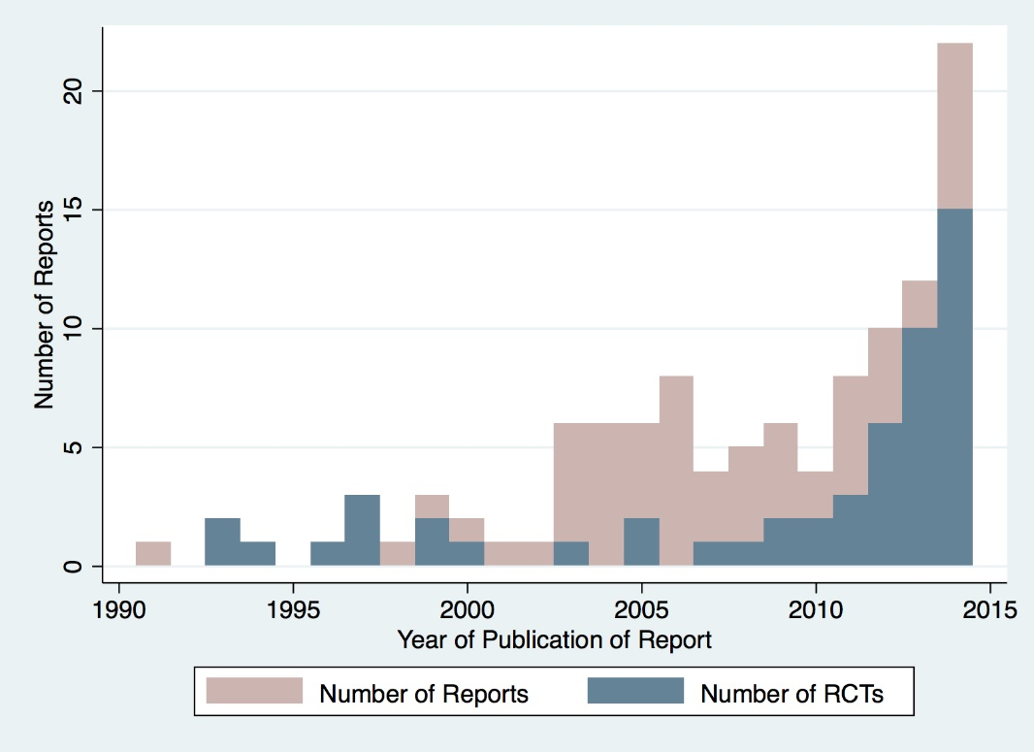
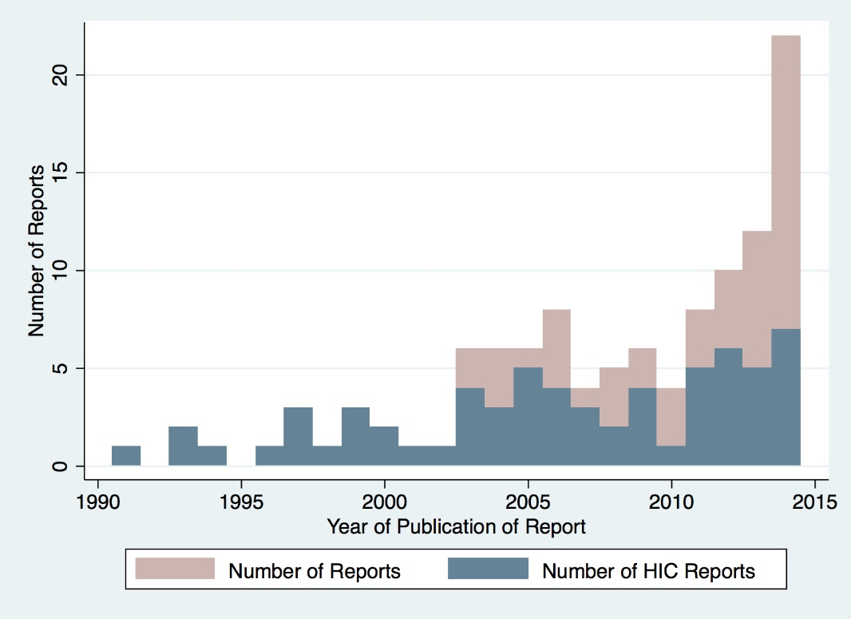
evaluation design & coverage
Total number of reports and reports relying on RCTs by year of publication
Total number of reports and reports from high-income countries (HICs) by year of publication
Notes:
Experimental: RCTs; Quasi-experimental: studies that relied on methods for causal inference under unconfoundedness (PSM, regression methods); natural experiments: RDD, DID, IV
Better evidence base
In particular in low-income countries
2014, 12 out of 15 RCTs included in this review were from non-OECD countries, mainly Sub-Saharan Africa
large share of (randomized) experimental studies

Slide 19
INTERVENTIONS
Main category of intervention
Regions and country income type
Notes:
The 113 studies included in this review cover a wide range of countries from all major world
regions. A large share of the interventions that are evaluated have been implemented in OECD countries. Another large share of studies comes from Latin America and the Caribbean, where many countries have experimented with ALMPs – in particular, skills training – and started to evaluate their impact early in the 1990s using quasi-experimental and experimental designs. We are able to include a relatively large number of recent ALMP evaluations from Sub-Saharan Africa (15), which contrasts with the number of evaluations found in other developing and emerging regions, such as Europe and Central Asia and South Asia, with four interventions each, respectively.

Slide 20
Sample and methods
Notes:
The review relies on reported treatment effect as a measure of impact. The search and screening process led to the identification and coding of 3,629 treatment effects.
Missing information.
Based on the reported (or inquired) information, it was possible to compute the direction and statistical significance for 3,105 treatment effect estimates.
PSS stands for Indicator of Positive Statistically Significant Treatment Effect Estimates. Treatment effect significant at the 5% level.
- The computation of SMD requires further information (at least the number of observations in treatment and/or comparison groups). Even after imputing missing information, it was only possible to compute the SMD from 2,259 reported treatment effect estimates. Standardized Mean Differences (SMD) Effect Size: $Y_{i}=\frac{β_{i}}{η_{i}}$
$β_{i}$ : Treatment effect estimate
$η_{i}$ : Standard deviation of the outcome variable
Standard Error of SMD: $σ_{i}=\frac{Y_{i}}{t_{i}}$
$t_{i }:$t-statistic associated with the treatment effect $β_{i}$
Aggregation of Effect Size Estimates
Multiple Studies per Intervention
Multiple Reports per Study
Multiple Effect Sizes per Report:
- Multiple outcomes, subgroup analysis, specifications
- Average Nr. of Treatment Effect Estimates per study: 12
→ Goal: Independent sample populations for each intervention in order to account for dependencies within studies
→ Selection and/or Aggregation
Summary Effect Size: $Y_{j}=\frac{1}{m}\sum_{i=1}^{m}{Y_{ij}}$
$σ_{j}=\sqrt{{\left(\frac{1}{m}\right)}^{2}\left(\sum_{i=1}^{m}{σ_{i}^{2}}+\sum_{i≠k}{ρ_{ik}σ_{ij}σ_{kj}}\right)}$
$ρ_{ik}$ : correlation coefficient between $Y_{ij}$ and $Y_{kj}$

Slide 21
findings
Investing in youth through ALMPs pays off.
It is however an investment that needs time to grow.
Context matters: intervention types are not associated with greater outcomes with statistical significance. Some patterns emerge by country income group.
Design matters:
      Profiling participants to provide services that meet individual constraints are a driver of greater impacts.
      Mechanisms to improve participant engagement - through providing incentives or emphasis on supervision/monitoring - leads to greater outcomes.
      Incentives to providers might be important; more analysis is needed
Notes:
Investing in youth through ALM measures may improve outcomes: Increasing chances finding or staying in employment and improving their income.
Similar Statistically Significant with effect sized SMD of (employment) 0.04 and (earnings) 0.05. With substantially less evidence, the effect on business performance outcome was statistically significant at 0.03 SMD.
However when only entrepreneurship promotion was considered its impact was larger and significant SMD 0.10.
Programme impacts conceal major contextual differences, tests for heterogeneity showed substantial variation in the effects size magnitude due to: Profile of the benefeciaries, Design and Implementation of the interventions and, Country Income Level.
Design matters: Profiling participants to provide services that meet individual constraints are a driver of greater impacts. Mechanisms to improve participant engagement - through providing incentives or emphasis on supervision/monitoring - leads to greater outcomes. Incentives to providers might be important; more analysis is needed

Slide 22
findings
Intervention Characteristics and Research design vary significantly
Impact is Higher in LMIC than in HIC
In LMIC entrepreneurship promotion and skill training offer greatest impacts
In HIC the role of the intervention type is less tangible
Programs lead to better outcomes when they target low income and disadvantaged youth
No clear indication about the impact that public, private or civil society bring to the equation
Notes:
It means that in HIC a large proportion are quasi experimental studies of natural programmes implemented in collaboration with government organizations.
In MLIC – majorly based on experimental impact evaluations of rather small scale, targeted interventions are often implemented by NGO’s.
Impact is higher in low- or middle-income countries than in high-income countries. It stresses the fact that being unemployed or unskilled in a high-income country – where labour demand is skill intensive – puts youth at a distinct disadvantage in comparison to a cohort that is, on average, well educated. So the intervention may (re)connect youth to the labour market, yet they do not fully compensate for any failure to acquire knowledge or skills earlier in the education system.
In lower income countries, with large cohorts of disadvantaged youth, marginal investments in skills and employment opportunities lead to larger changes in outcomes.
In low- and middle-income countries, skills training and entrepreneurship interventions produce the greatest impacts. This is an important finding, which highlights the merits of combining both supply- and demand-side interventions to support youth. It also provides tangible evidence about the effect of interventions that aim to build human capital.
Despite their large effect, entrepreneurship promotion interventions also exhibited great variability, which calls for further research to enhance the consistency of the results from this intervention type.
In low-and middle-income countries, measures that provide multiple services and programme components to youth lead to better outcomes. Interventions that combine different components report higher outcomes than otherwise. The same relationship is not seen among interventions implemented in high-income countries.
In high-income countries, the role of intervention types is less decisive. No single type of intervention provided clear evidence of a significant effect on the employment or earnings outcomes of youth in high-income countries.
Programs lead to better outcomes when to low income and disadvantaged persons. Measures of targeting, a focus on LI or youth with low levels of education triggers higher employment and earnings for youth across all country income levels.
While overall effect size for employment and earnings appear to be larger for young women than young men. No patterns in the multivariate regression analysis to suggest that targeting only women will lead to better outcomes.
While involvement of public and private entities in the implementation of a youth employment programme leads to positive results in HIC, in LMIC it was not significant or negative. More research is needed to and civil society

Slide 23
findings
Careful design of interventions. The “how” seems to be more important than the “what”. Focusing on the beneficiaries and schemes to motivate the service providers to perform effectively may be the key to success.
Notes:
Emphasize to be put on the ability of specific design features within employment interventions to affect individual behaviors (among young people and service providers). The findings of this review needs to be discussed viz a viz at the local and national context and should be complemented by a long-term and holistic commitment towards youth development.
Much remains to be done to improve reporting standards and advocate for more anbetter evidence examining the impact of youth employment interventions. Although for the research only 9% of studies were judged to have a low level of rigour.
While

