Slide 1
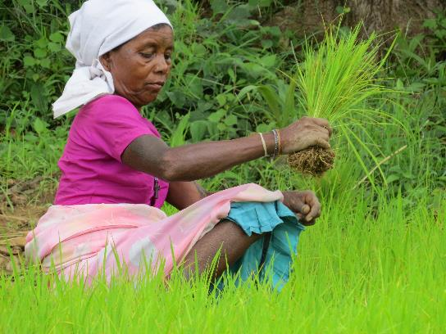
Climate-smart and sustainable agriculture in the face of climate change: overcoming barriers (GDN)
Overcoming Barriers to the Pursuit of Climate Resilient Agriculture: Looking Beyond the Farm
22nd March 2018

Slide 2
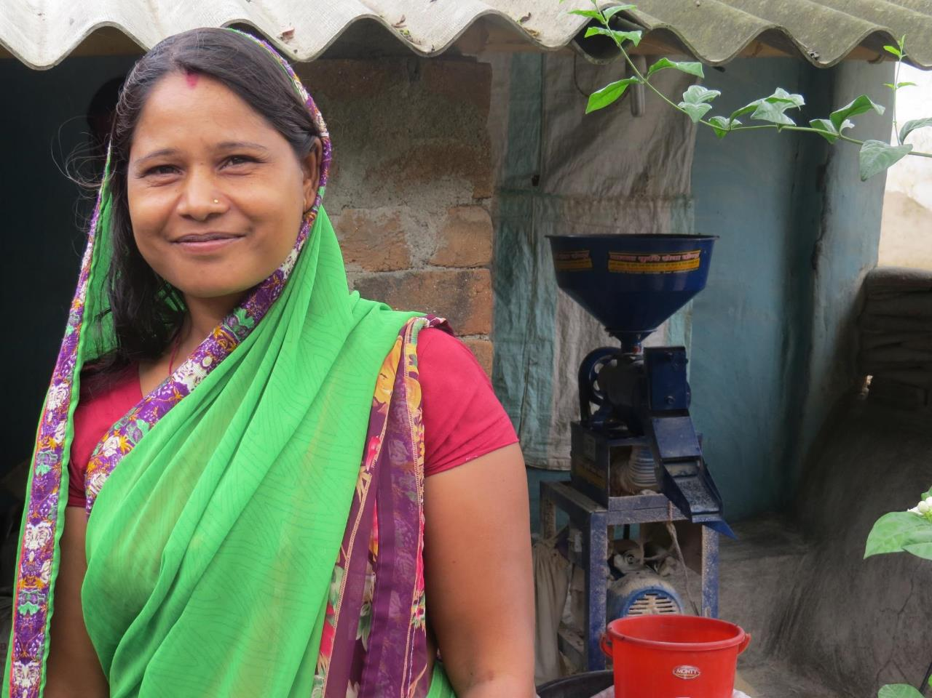
Project overview
WHERE THE RAIN FALLS: A COMMUNITY-BASED ADAPTATION INITIATIVE
Objective: 4500 Adivasi women and girls are empowered, participate effectively in governance, and have enhanced resilience to chronic risks arising out of climate change
Operational areas: 40 villages in Jashpur district, in 2 blocks Bagicha & Pathalgaon ( 20 villages in each block) and one block in (Jalgaon Jamod) Buldhana district to reach 10 additional villages

Slide 3
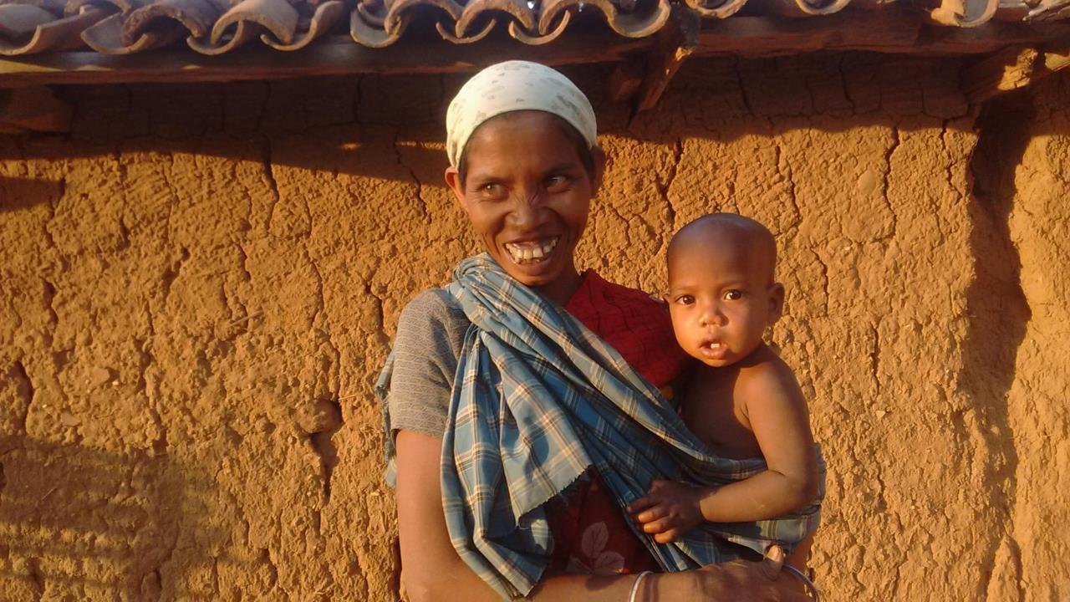
CLIMATE RESILIENT AGRICULTURE Formation of Farmer Field Schools (80 in 40 villages) Promotion of System of Rice Intensification (SRI) 700 Farmers Promotion of mixed cropping – 800 farmers; promotion of pulses – 600 farmers Training farmers on bio pesticide and organic manure Leveraged agri-inputs & equipment (INR 1.2 million)
SOIL AND WATER CONSERVATION 5% Model: 800
Percolation tanks: 120
Earthen check dams: 2
Ponds: 4
Contour trenching
Sensitization on improved water management
Household (HH) participatory water audit tool: 275 HHs
Volunteers trained on water audit: 40

Slide 4
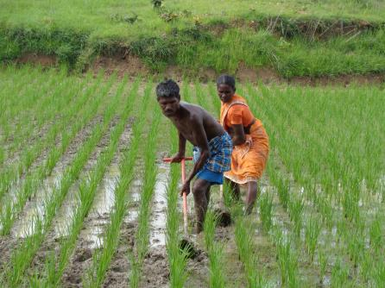
INCLUSIVE RESOURCE GOVERNANCE Village Development Committees (VDC) organized: 40 Panchayat level leaders trained:124 Joint Forest Mana/gement Committees strengthened: 20 Scenario Planning; village level Community Action Plans (CAP) for Adaptation prepared and implemented: 40
FINANCING & INSURING LIVELIHOODS SHGs strengthened: 172 & self-rating of SHG quality promoted (SQAT)
Savings: INR 2.3 million; bank credit
Alternate Livelihood support for income diversification: 25 SHGs
Insurance literacy & linkages based on a demand and risk assessment study
Ag-met pilots in village clusters; mobile based agriculture and meteorological support to 320 farmers

Slide 5
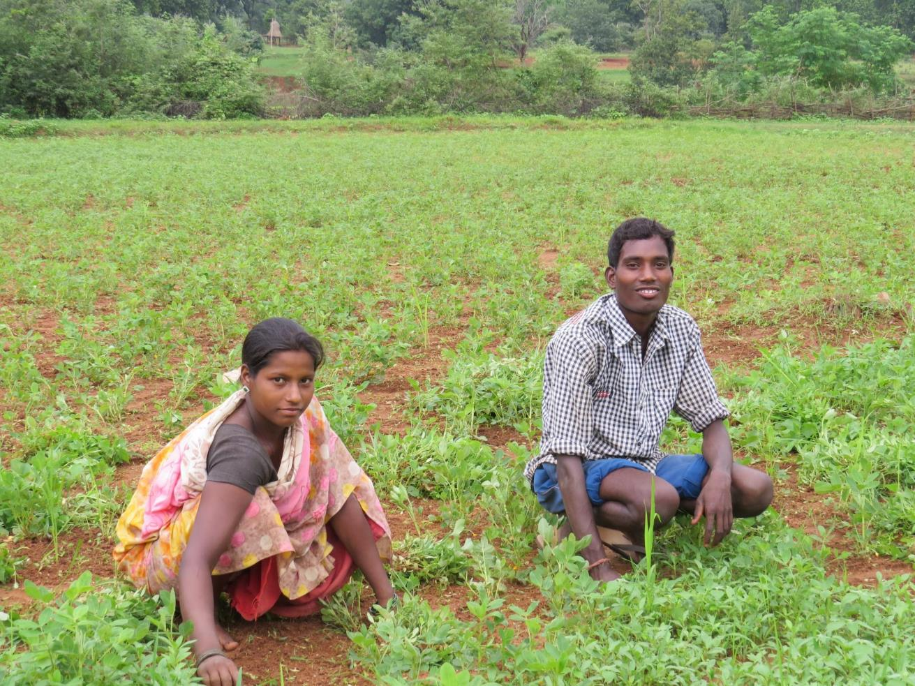
GENDER TRANSFORMATIVE CHANGE
Gender analysis: 40 villages
REFLECT circles and dialogues in communities to reflect over gender norms periodically
SHG members trained: 350
VDCs sensitized: 40
PRI members sensitized: 64
Men sensitized: 160

Slide 6
Measuring Change (1/2)
Adoption Rates | Baseline Status (% farmers) | Current Status (% farmers)
System of Rice Intensification/ Line Sowing | 4.3 | 59.9
Mixed cropping | 30.1 | 50.9
Bund plantation | 3.6 | 15.6
Integrated nutrient management | 25.3 | 31.1
Farm ponds | 6.7 | 25.9

Slide 7
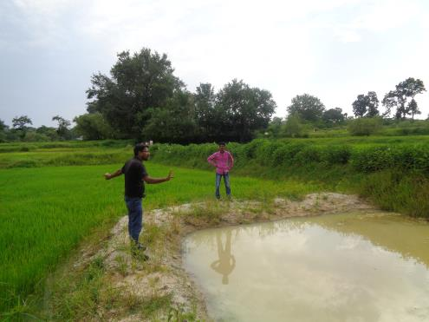
Measuring Change (2/2)
Areas of Intervention | Baseline status | Current Status
Productivity of Paddy | 3.15 Q/acre | 15.91Q/acre
Number of days in a year when households could not eat the minimum threshold quantity of cereals | 49 days | 32 days
Food insecurity fear in the intervention areas | 12.5% HH | 3.2% HH
Average number of days in a year when participant households migrated in distress, for labour work | 31 days | 12 days
Adivasi women voicing at least one vulnerability related issue in any multi-stakeholder forum | 7.2 % | 26 %

Slide 8
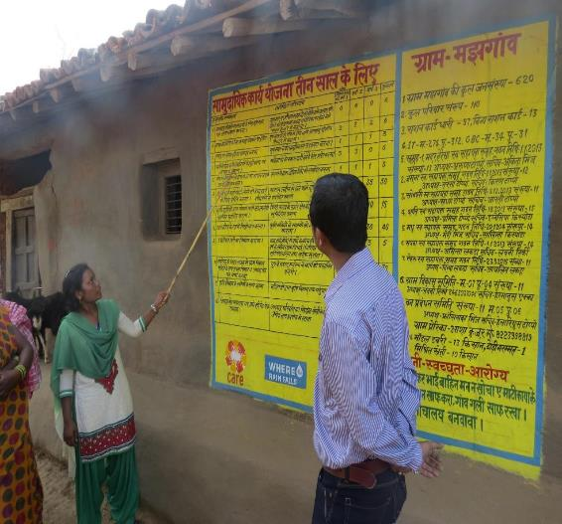
The Replication Challenge
Financial System & Markets
Communication and Technology Networks
Agriculture System
Human Aspirations and Frailties
Natural System
Gender relations and Social norms

Slide 9
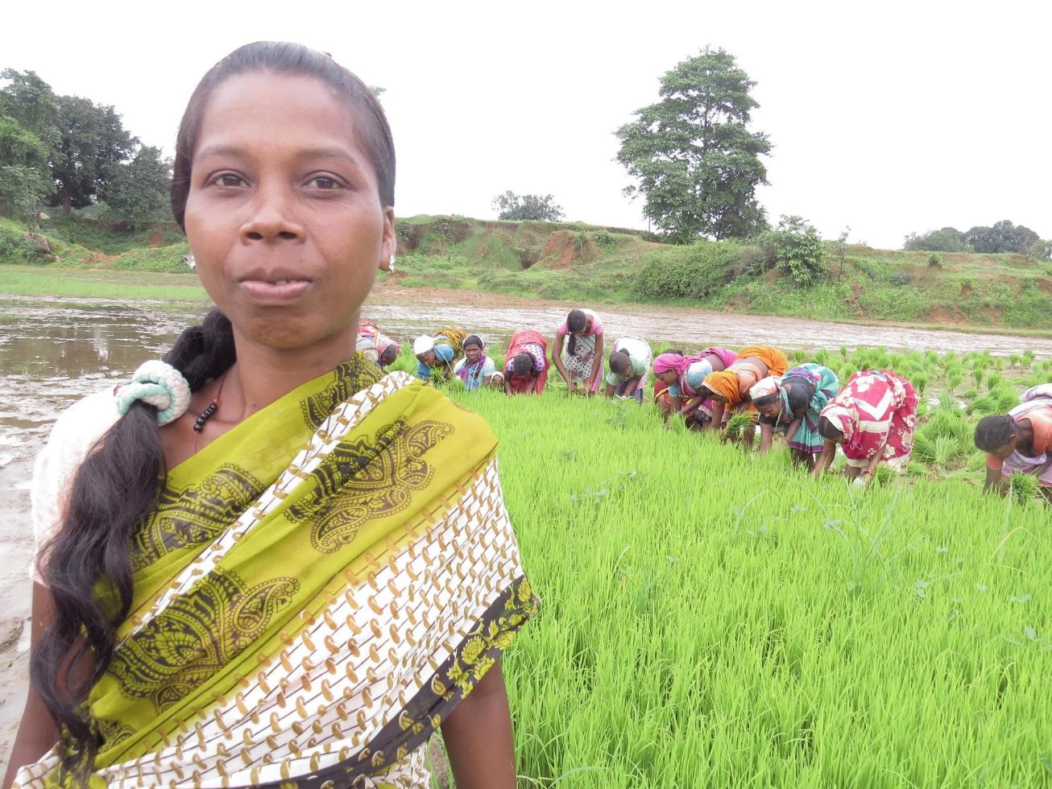
AREAS FOR RESEARCH
What does a climate resilient livelihood basket of a smallholder look like?
Components and thresholds of adaptive capacity of smallholders
Integrated Knowledge and Information System for Climate Resilient Agriculture
Gender Analysis: Climate Vulnerability and Resilience
Economics of Water Resource Planning
Seed, Soil, Water and Energy: Appropriate Technologies and Innovations for the poor
Evolving a robust financial and market system for climate vulnerable areas
Credit needs assessment and willingness to pay studies

Slide 10
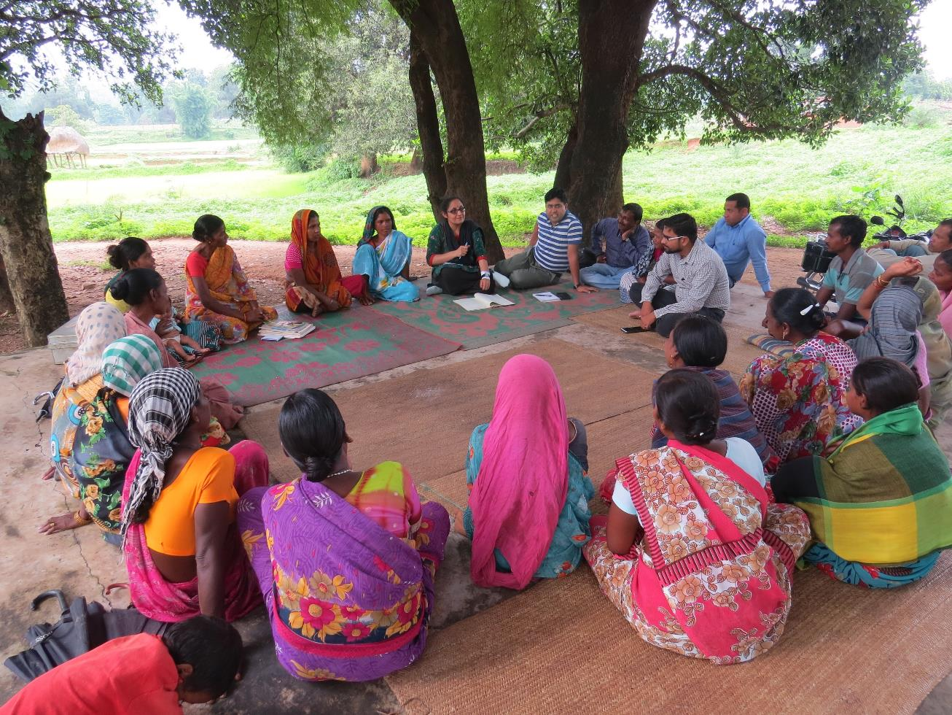
Thank You

