Slide 1
Promotion of Coffee certification and contract farming for better livelihood : The case of Ethiopia
Yadeta Bekele
Jimma University ,Ethiopia

Slide 2
Profits from Black Gold: Coffee Arabica

Slide 3
Introduction
Coffee is a cash crop standing 2nd to oil in fetching foreign exchange in developing countries
According FAO, Ethiopia stands 5th in production of coffee
Coffee in Ethiopian economy accounts 35% of agricultural export earnings and 10-20% of government revenue
Ethiopia exports only 40 to 45% of the total coffee it produces and the rest is consumed locally because of quality problems.

Slide 4
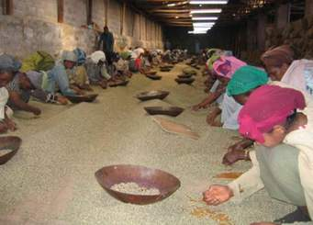
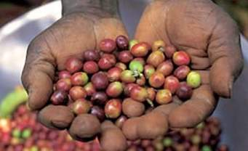
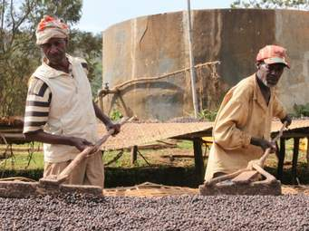
Cont’d…
Farmers manually collect coffee beans contributing to quality reduction

Slide 5
Introduction Cont’d……
Globally, certification and contract farming has received strong recognition
A few companies have organized small scale producers under certification and contract farming schemes

Slide 6
Introduction Cont’d……
Evidences show that certification Programs have improved the social, economic and environmental conditions of smallholder farmers
Source: Fikadu Mitiku, Yann de Mey, Jan Nyssen and Miet Maertens,2017
Variables | Non-certified coffee | Certified coffee
 |  | Fair Trade | Rainforest Alliance
Coffee area (ha) | 0.65 | 0.58 | 1.44
Share of dry coffee supplied (%) | 100 | 100 | 91.11
Coffee yield (kg/ha) | 631.5 | 682.5 | 618.46
Coffee income (ETB) | 3747.53 | 4425.51 | 17051.8
Household income (ETB) | 9036.12 | 6259.68 | 24462.58
Poverty (%) | 81 | 89 | 48

Slide 7
Introduction Cont’d……
In Ethiopia the share of certified coffee is significantly lower than in other countries not more than 2-3% of the total production
So the country is forgoing rewards of the price premiums from certification schemes

Slide 8
Significance and scope of the study
Poverty reduction through market-led strategies for economic growth is one of the country’s agenda
Agricultural policy of the country highly focused on commercialization of small scale production
So development of viable market linkages which the policy actions still lack at the lower end of value chains attracts the researchers’ attention

Slide 9
Cont’d…
The capacity of smallholder farmers to produce the required quality and quantity is not well developed
Integrating smallholder farmers to higher markets using different marketing schemes like certification and contract farming are another options
Therefore this study will be used as a complement for the country’s policy

Slide 10
Rationale of the study
In Ethiopia smallholder farmers face three major problems
They do not have full information what quality and quantity is demanded in the market and what prices are being paid for their crop in regional markets
Farmers do not have access to warnings about weather condition
Extension workers could not reach all the farmers to train them in production techniques due to poor infrastructures

Slide 11
Cont’d….
Hence farmers are losing price premium
The country is losing huge foreign earnings
The government gave due attention on quality controls through ECX but private coffee traders collect coffee from farmers which unfit the required standards
Coffee producers, cooperatives, projects and other governmental organizations will be involved in the study

Slide 12
Framework of the concept
Farmers do not have full information about the quality and quantity of coffee demanded in the market
Coffee cooperatives and private traders are collecting huge coffee from farmers and sell to ECX
Private exporters supply uncertified coffee with relatively low price
ECX controls the quality of coffee from cooperatives and traders
The country is losing huge price premium and missing its coffee brand in the international markets

Slide 13
Objectives of the research
This study will have two dimensions (Intervention and Impact analysis) with the following objectives
To identify determinants of smallholder farmers’ coffee certification and contract farming participation
To estimate the impact of coffee certification and coffee contract farming participation on the income of smallholder farmers

Slide 14
Objective Cont’d…
To assess gender mainstreaming approach in the coffee certification and contract farming
To conduct comparative analysis between certified and uncertified, contract farming participants and non-participants

Slide 15
Research questions
What are the factors that determine smallholder farmers to be certified and not to be certified in coffee production?
What are the factors determining the participation decision of smallholder farmers in coffee contract farming?
What is the extent of smallholders’ coffee supply in contract farming?
What are the impact of coffee certification and coffee contract farming participation on the income of smallholder farmers?

Slide 16
Cont’d….
How do certified and uncertified coffee producers differ in their access to education, extension services, market information, gender equality and income from coffee?

Slide 17
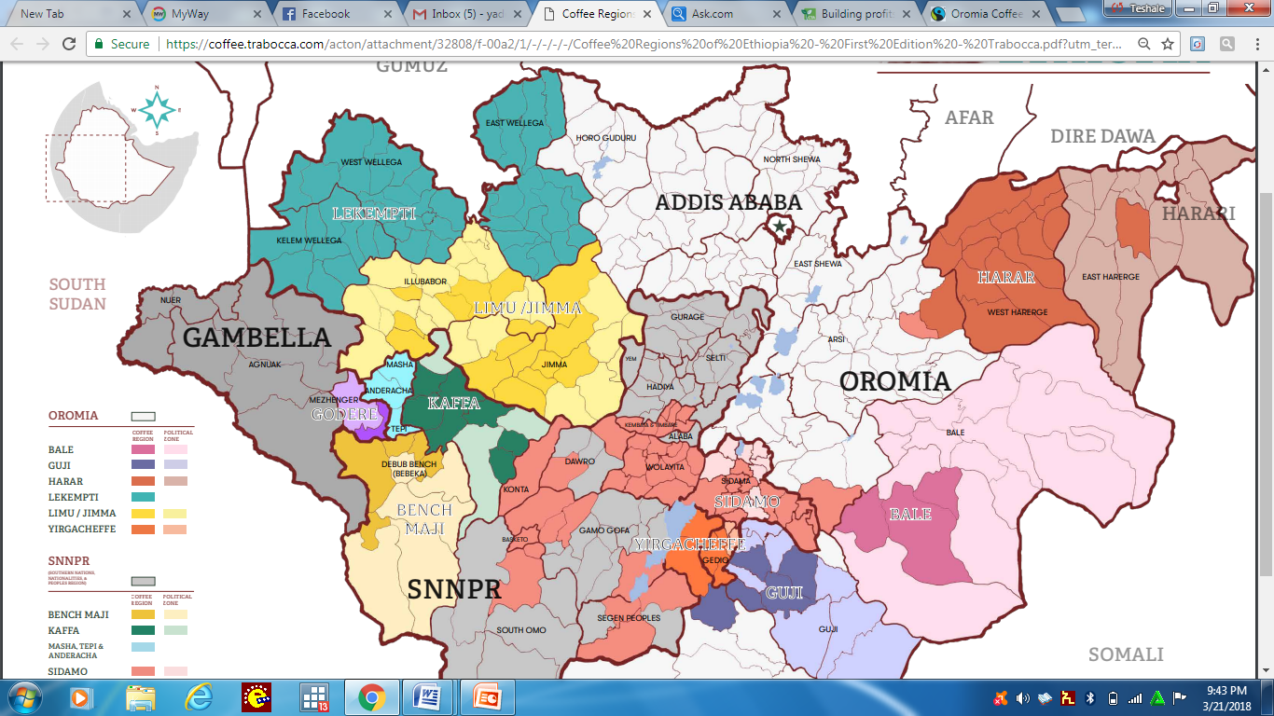
Methodology
The study will be conducted in south western part of the country

Slide 18
Cont’d….
Both qualitative and quantitative data will be collected
Structured questionnaire will be used to collect data from certified, uncertified, contracted and non-contracted coffee producers

Slide 19
Cont’d….
Focus group discussions and key informant interview will also be used
Secondary data will be collected from different governmental and non-governmental organizations which are found in the area

Slide 20
Cont’d….
To analyze the data, different statistical methods will be employed
Tobit model will be used to identify factors influencing coffee contract farm and coffee certification participations decisions and level of their participation
Propensity score matching will be used to analyze the effect of contract farming and coffee certification on the income level of smallholder farmers

Slide 21
Policy Implications
Coffee certification is an instrument to add value to the product
It addresses a growing worldwide demand for healthier and more socially and environmentally friendly products
It is based on the idea that consumers are motivated to pay a price premium for products that meet certain precisely defined and assured standards
Labeling a product as ‘organic’ or ‘Fairtrade’ is considered a valuable marketing advantage in today's consumer markets.

Slide 22
Cont’d….
The price premiums are intended to be used to promote socio-economic change
Voluntary product certification standards will be promoted as critical devices to make small-scale farmers less vulnerable to volatile market prices and to enhance their market integration
So this study has policy implications of producing a quality coffee through certification for international markets
Integrating small-scale farmers to different markets through contract farming enables them to harvest high price premium

Slide 23
Cont’d…
There is also climate change implication through forest conservation and gender equality due to coffee certification
Policy relating to agricultural commercialization and upgrading of small scale farmers by integrating them to fair markets will get due attention in the area

Slide 24
Thank You

