Slide 1
Global Development Conference on STI for Development 22-23 March 2018
Skilling a Labour Force for the Manufacturing Sector: An Analysis of Trends in Intake Capacities in Engineering Education
H. Ramachandran
Visiting Professor, ISID

Slide 2
Skilling a Labour Force for the Manufacturing Sector
There are two streams through which skills are developed among the prospective labour force in many sectors:
(a) the informal stream and
(b) the formal stream where skills are offered through a structured curriculum at various levels

Slide 3
Skilling a Labour Force for the Manufacturing Sector
With increasing international tenders, the demand for a certified labour force is also increasing.
the Ministry of Human Resource Development has been toying with the idea of testing and certification centres at district level that could address the labour force coming out of stream (a) .

Slide 4
Skilling a Labour Force for the Manufacturing Sector
Government of India launched The National Skill Development Mission
The Mission Directorate will be supported by three other institutions: the National Skill Development Agency (NSDA), the National Skill Development Corporation (NSDC), and the Directorate General of Training (DGT).

Slide 5
Educational and Training Institutions in India
The backbone of development of a skilled labour force for the manufacturing sector is the troika of engineering colleges (degree level and above), polytechnics (diploma level) and Industrial Training Institutes (certificate level).
The General Educational Institutions of Science and Humanities which have interface with Technical Education

Slide 6
Supply and Demand Sides of Skills in Labour Force
The labour force normally is distributed in a pyramidal manner, with a large numbers at the lower end of skill pyramid and tapering off with increasing level of skills.
As a result, the intake in various skill building institutions also tapered off with the increasing level of skills for many years in India

Slide 7
Skill Demand Pyramid
India Brand Foundation has quoted an IMaCS study that worked out sector specific skill levels required .
The industry average as brought out by that study of reproduced in the next slide.

Slide 8
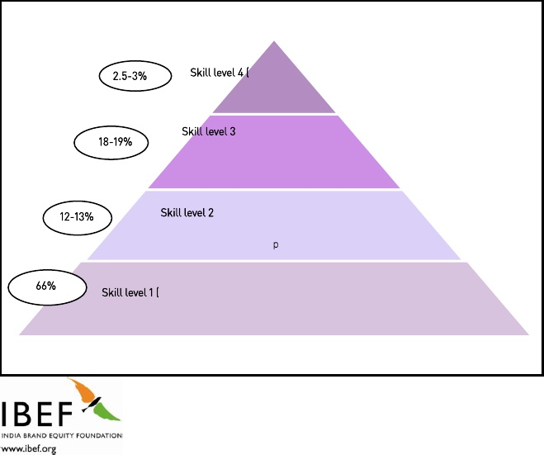
Skill Level Requirement

Slide 9
Supply Side
Post 1980, we find a larger intake capacity at the degree level than at diploma level -a result of the entry of private engineering colleges.
This increase was also fuelled by the growing demand for a skilled labour force in the globalised and privatised economy.
Many of these institutions were not able to fill even 50 per cent of their intake capacity even during 2002 and now its is 30 per cent.
Request to AICTE to hold back further approval of new colleges.

Slide 10
Supply Side of Education and Skill
Institutional Level | Intake Capacity | Year
Higher Education (General) | 2,360,000 | 2015-16
UG + PG Engineering | 1,750,827 | 2016
Diploma Engineering | 1,303,669 | 2015-16
ITIs & ITCs | 1,865,620 | 2016

Slide 11
Concluding Points – Quote from 2003 paper
Earlier the intake capacity ratio between Degree and Diploma level was 1:1.5. This has been reversed.
Unemployed engineers are increasing
Large proportion of intake capacity is under Utilized – yet new institutions are being established
Type of Skills in demand and those supplied do not match

Slide 12
Concluding Points
As per Sharada Committee (appointed by the Ministry) report since the scheme included monetary reward for the trainees the achievement was more than the target – achievement to the tune of 3 million.
The committee found everybody was chasing numbers without providing employment to the youth or meeting sectoral industry needs.
Data shows that the NSDC, through its partners, only managed to skill around 600,000 youth till September 1, 2017 and having a placement rate of around 12 per cent.
Much of these efforts under the scheme were through short term training courses and as a result placement of the trainees was difficult.

Slide 13
Concluding Points
What we need is Human Resource mapping for a twenty year time period based on a robust system of projecting demand for different types and levels of skill, rather than supply-driven skilling efforts.

